Slide 1
Satisfiability
Verifying cyberphysical systems
Sayan Mitra
mitras@illinois.edu
Some of the slides for this lecture are adapted from slides by Clark Barrett

Slide 2
Readings
Chapter 7
Appendix C
Outline
Propositional Satisfiability problem
Normal forms
DPLL algorithm

Slide 3
Boolean satisfiability problem
Given a well-formed formula in propositional logic, determine whether there exists a satisfying solution
Example: $α\left(x_{1},x_{2},…,x_{n}\right)≡\left(x_{1}∧x_{2}∨x_{3}\right)∧\left(x_{1}∧¬x_{3}∨x_{2}\right)$
Set of variables: $X=\{x_{1},x_{2},…,x_{n}\}$,
Each variable is Boolean: $type\left(x_{i}\right)=\left\{0,1\right\}$
Formula $α$ is well-formed if it uses propositional operators, and $∧,$ or $∨$, not $¬,$iff $↔$ etc., properly
Recall, a valuation x of $X$ maps each $x_{i}$ to a value 0 or 1
A valuation x of $X$ satisfies $α$ is each each $x_{i}$ in $α$ replaced by the corresponding value in x evaluates to true. We write this as $x⊨α$
Otherwise, we write $x⊭α$
Example: with $x≡⟨x_{1}↦1,x_{2}↦1,x_{3}↦0⟩$; $x⊨α$
Notes:
We’d want to solve formulas with millions of variables

Slide 4
Boolean satisfiability problem (SAT)
Given a well-formed formula in propositional logic, determine whether there exists a satisfying solution
Restatement: $∃x∈val\left(X\right):x⊨α?$
If the answer is ”No” then $α$ is said to be unsatisfiable
Aside. If $∀x∈val\left(X\right):x⊨α$ then $α$ is said to be valid or a tautology
If $α$ is valid then $¬α$ is unsatisfiable
$α$ and $α′$ are tautologically equivalent if they have the same truth tables
$$∀x∈val\left(X\right):x⊨α↔x⊨α^{′}$$
What is a naïve method for solving SAT?
What is the complexity of this approach? How many evaluations of $α\left(x_{1},x_{2},…,x_{n}\right)$?
Notes:
Ans. Construct truth table
Ans. $2^{n}$

Slide 5
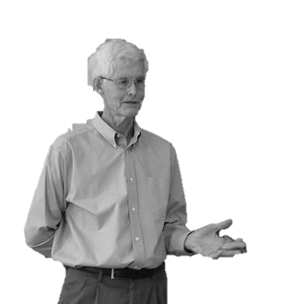
I Don’t Get No Satisfaction, but I try, try, try,…
I can prove why.
Prof. Cook
Stephen A. Cook: The Complexity of Theorem-Proving Procedures. STOC 1971: 151-158
Slide by Sayan Mitra using pictures
from Wikipedia and cartoonstock.com

Slide 6
SAT is NP-complete
SAT was the first problem shown to be NP-complete [Cook 71]
2-SAT can be solved in polynomial time (Exercise)
(Read definition of NP: Nondeterministic Polytime in Appendix C)
This has real implications
Essentially we don’t know better than the naïve algorithm
A solver for SAT can be used to solve any other problem in the NP class with only polytime slowdown. i.e., makes a lot of sense to build SAT solvers
SAT/SMT solving is the cornerstone of many verification procedures
Stephen Cook, The complexity of theorem-proving procedures. In Proceedings of the third annual ACM symposium on theory of computing. STOC ‘71.
Notes:
“Collective facepalm at Berkeley”
https://www.quora.com/Why-did-Berkeley-deny-Stephen-Cook-one-of-whom-the-Cook-Levin-Theorem-in-computational-complexity-is-named-after-reappointment-as-a-professor

Slide 7
Details
We will assume $α$ to be in conjunctive normal form (CNF)
literals: variable or its negation, e.g., $x_{3}$, $¬x_{3}$
clause: disjunction (or) of literals, e.g., $\left(x_{1}∨x_{2}∨{¬x}_{3}\right)$
CNF formula: conjunction (and) of clauses,
e.g., $\left(x_{1}∨x_{2}∨{¬x}_{3}\right)∧$ $\left(¬x_{2}∨x_{1}\right)$
A variable may appear positively or negatively in a clause

Slide 8
Logic and circuits
D
A
B
I
C
$$I≡\left(D∧\left(A∧B\right)\right)∨\left(¬C∧\left(A∧B\right)\right)$$
Repeated subexpression is inefficient
Solution: rename $\left(A∧B\right)↔E$
$$I^{′}≡\left(D∧E\right)∨\left(¬C∧E\right)∧\left(\left(A∧B\right)↔E\right)$$
$I$ and $I′$ are not tautologically equivalent
$C=0, A=B=1, E=0$ satisfies $I$
But they are equisatisfiable, i.e., $I$ is satisfiable iff $I′$ is also satisfiable

Slide 9
Converting to CNF
View the formula as a graph
Give new names (variables) to non-leafs
Relate the inputs and the outputs of the nonleafs and add this as a new clause
Take conjunction of all of this

Slide 10
Converting to CNF
$F↔¬C$
$F→¬C∧¬C→F$
$\left(¬F∨C\right)∧(¬C∨F)$
$\left(A∧B\right)↔E$
$\left(\left(A∧B\right)→E\right)∧\left(E→\left(A∧B\right)\right)$
$\left(¬\left(A∧B\right)∨E\right)∧\left(¬ E∨\left(A∧B\right)\right)$
$\left(¬A∨¬B∨E\right)∧\left(¬ E∨A)∧\left(¬E∨B\right)\right)$
$\left(G∨H\right)↔I$
$\left(\left(G∨H\right)→I\right)∧\left(I→\left(G∨H\right)\right)$
$\left(¬G∧¬H∨I\right)∧\left(¬I∨G∨H\right)$
$\left(¬G∨I ) ∧(¬H∨I\right)∧\left(¬I∨G∨H\right)$
$\left(D∧E\right)↔G$
$\left(¬D∨¬E∨G\right)∧\left(¬ G∨D)∧\left(¬G∨E\right)\right)$
$\left(F∧E\right)↔H$
$\left(¬F∨¬E∨H\right)∧\left(¬ H∨F)∧\left(¬H∨E\right)\right)$
D
G
A
E
I
B
C
H
F

Slide 11
Standard representations of CNF
$\left(¬A∨¬B∨E\right)∧\left(¬ E∨A)∧\left(¬E∨B\right)\right)$
$\left(A^{′}+B^{′}+E\right){(E}^{′}+A)\left(E^{′}+B\right)$
$\left(−1 −2 5\right)\left(−5 1\right)\left(−5 2\right)$ DIMACS
SMTLib

Slide 12
Davis Putnam Logemann Loveland Algorithm (DPLL) 1962
Transform the given formula $α$ by applying a sequence of satisfiability preserving rules
If final result has an empty clause then unsatisfiable
if final result has no clauses then the formula is satisfiable

Slide 13
Davis Putnam Algorithm (DP) 1960
Rule 1. Unit propagation
Rule 2. Pure literal
Rule 3. Resolution

Slide 14
DP 1960
Rule 1. Unit propagation
A clause has a single literal
$$α≡…∧…∧p∧…∧…$$
What choice do we really have?
$$α≡…∧\left(x_{1}∨¬p∨x_{2}\right)∧p∧…∧\left(¬x_{3}∨¬p∨x_{1}\right)…$$

Slide 15
DP 1960
Rule 1. Unit propagation
A clause has a single literal
$$α≡…∧…∧p∧…∧…$$
What choice do we really have?
$$α^{′}≡…∧\left(x_{1}∨x_{2}\right)∧…∧\left(¬x_{3}∨x_{1}\right)…$$
$α$ and $α′$ are equisatisfiable

Slide 16
Davis Putnam Logemann Loveland Algorithm (DPLL) 1962
Rule 1. Unit propagation
Rule 2. Pure literal
A literal appears only positively (or negatively) in $α$
$$α≡…∧\left(x_{1}∨¬p∨x_{2}\right)∧(x_{4}∨¬p)∧…∧\left(¬x_{3}∨¬p∨x_{1}\right)…$$
$p$ does not appear anywhere
Makes sense to set $p=0$ and remove all occurrences of $¬p$

Slide 17
Davis Putnam Logemann Loveland Algorithm (DPLL) 1962
Rule 1. Unit propagation
Rule 2. Pure literal
A literal appears only positively (or negatively) in $α$
$$α≡…∧\left(x_{1}∨¬p∨x_{2}\right)∧(x_{4}∨¬p)∧…∧\left(¬x_{3}∨x_{1}\right)…$$
$p$ does not appear anywhere
Makes sense to set $p=0$ and remove all clauses in which $¬p$ occurs
$α^{′}≡…∧…∧…∧\left(¬x_{3}∨x_{1}\right)…$ [$p=0]$
$α$ and $α′$ are equisatisfiable

Slide 18
Davis Putnam Algorithm (DP) 1960
Rule 1. Unit propagation
Rule 2. Pure literal
Rule 3. Resolution
Choose a literal $p$ that appears with both polarity in $α$. Suppose $(ℓ_{1}∨ℓ_{2}∨…∨p)$ be a clause in which $p$ appears positively, and $(k_{1}∨k_{2}∨…∨¬p)$ be a clause in which $p$ appears negatively
Then the resolved clause is $(ℓ_{1}∨ℓ_{2}∨…∨k_{1}∨k_{2}∨…k_{m})$
Pairwise, resolve each clause in which $p$ appears positively with a clause in which $p$ appears negatively, and take the conjunction of all the results
Why is the result equisatisfiable?
What is the size of the resulting formula?
Notes:
Quadratic blow-up in size

Slide 19
DPLL modifies resolution in DP with recursive DFS rule
Rule 1. Unit propagation
Rule 2. Pure literal
Rule 3’. Let $Δ$ be the current set of clauses. Choose a literal $p$ in $Δ$.
Check satisfiability of $Δ∪\left\{ p \right\}$ (guessing $p=1$)
If satisfiable then return True else
return result of checking satisfiability of $Δ∪\left\{ ¬p \right\}$
This is essentially a depth first search

Slide 20
A simple greedy algorithm for SAT (GSAT)
Input: Set of clauses C over X, parameters max-flips, max-tires
Output: A satisfying assignment for C, or $∅$ if none found
for i = 1 to max-tries
$v$ := random truth assignment in val(X)
for j = 1 to max-flips
if $v⊨C$ then return $v$
$p≔$ variable in C such that flipping its value gives the largest increase in the number of clauses of C that are satisfied by $v$
$v≔v$ with the assignment to $p$ flipped
return $∅$

Slide 21
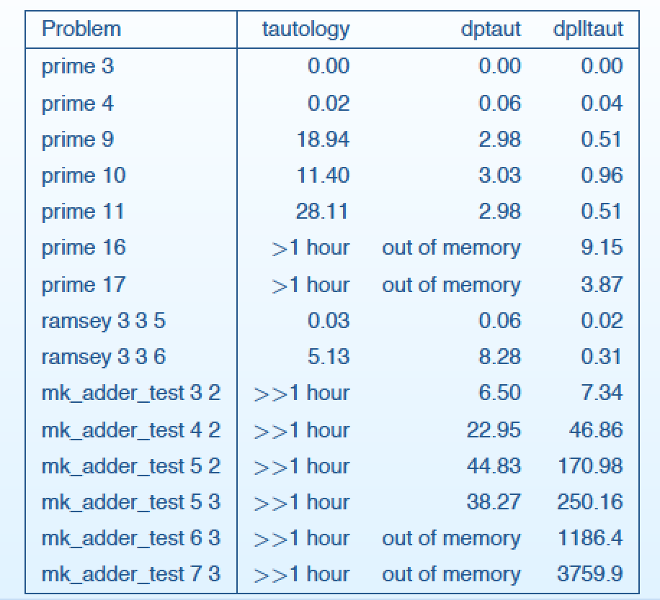
Experimental results on SAT solving
From Slides of Clark Barrett’s lecture.
Summer School on Verification Technology, Systems & Applications, September 17, 2008 – p. 42/98

Slide 22
Stålmarck’s algorithm
Breadth first search instead of depth-first
Given a set of clauses $Δ$ and any basic deduction algorithm R, the dilemma rule performs a case split on some literal $p$ by considering the new sets of clauses $Δ∪\{\left(¬ p\right)\}$ and $Δ∪\{\left(p\right)\}$ .
R is applied to each of these to get $Δ_{0}$ and $Δ_{1}$ respectively
The original $Δ$ is augmented with $Δ_{0}∩Δ_{1}$

Slide 23
Abstract DPLL
Abstract DPLL uses states and transitions to model the progress of the algorithm
Most states are of the form $M||F$ where
$M$ is a sequence of annotated literals denoting partial truth assignment
$F$ is the CNF formula being checked, represented as a set of clauses
Initial state: $∅||F,$ where $F$ is to be checked for satisfiability
Transitions between states are defined by a set of conditional transition rules
Final state
Fail special state, if $F$ is unsatisfiable, or
$M||G,$ where $G$ is CNF formula equisatisfiable with original $F$ and $M⊨G$
We will write $M⊨C$to mean that every truth assignment $v$, $v\left(M\right)=True$ implies $v\left(C\right)=True$
Abstract DPLL and Abstract DPLL Modulo Theories Robert Nieuwenhuis, Albert Oliveras, and Cesare Tinelli, 2006.

Slide 24
Abstract DPLL
UnitProp: $M||F, C∨ℓ$ | $$→M ℓ||F,C∨ℓ$$ | If $\left\{\begin{aligned}M⊨¬C \\ ℓ is undefined in M\end{aligned}\right.$
PureLiteral: $M||F$ | $$→M ℓ||F$$ | If $\left\{\begin{aligned}ℓ occurs in some clause of F \\ ¬ℓ occurs in no clause of F \\ ℓ is undefined in M\end{aligned}\right.$
Decide: $M||F$ | $$→M ℓ^{d}||F$$ | If $\left\{\begin{aligned}ℓ or ¬ℓ occurs in a clause of F \\ ℓ is undefined in M\end{aligned}\right.$
Backtrack: $M ℓ^{d} N ||F, C$ | $$→M ¬ℓ||F, C$$ | If $\left\{\begin{aligned}M{ ℓ}^{d} N⊨¬C \\ N contains no decision literals\end{aligned}\right.$
Fail: $M||F, C$ | $$→fail$$ | If $\left\{\begin{aligned}M⊨¬C \\ M contains no decision literals\end{aligned}\right.$
Abstract DPLL and Abstract DPLL Modulo Theories Robert Nieuwenhuis, Albert Oliveras, and Cesare Tinelli, 2006.

Slide 25
An Example: Abstract DPLL
$$φ||1∨\overline{2} \overline{1}∨\overline{2} 2∨3 \overline{3}∨2 1∨ 4$$
$⇒$ (PureLiteral)
4$||1∨\overline{2} \overline{1}∨\overline{2} 2∨3 \overline{3}∨2 \underline{1∨ 4}$
$⇒$ (Decide)
4 1^{d} $||\underline{1∨\overline{2}} \overline{1}∨\overline{2} 2∨3 \overline{3}∨2 1∨$4
$⇒$ (UnitProp)
4 1^{d} $\overline{2}$ $||1∨\overline{2}. \overline{1}∨\overline{2} 2∨3 \overline{3}∨2 1∨$4
$⇒$ (UnitProp)
4 1^{d} $\overline{2}$ 3 $||1∨\overline{2}. \overline{1}∨\overline{2} 2∨3 \overline{3}∨2 1∨$4
4 1^{d} $\overline{2}$ 3 $||1∨\overline{2}. \overline{1}∨\overline{2} 2∨3 \overline{3}∨2 1∨$4
$⇒$ (Backtrack)
4 $\overline{1} ||1∨\overline{2} \overline{1}∨\overline{2} 2∨3 \overline{3}∨2 1∨ 4$
$⇒$ (UnitProp)
4 $\overline{1} \overline{2}||1∨\overline{2} \overline{1}∨\overline{2} 2∨3 \overline{3}∨2 1∨ 4$
$⇒$ (UnitProp)
4 $\overline{1} \overline{2} 3 ||1∨\overline{2} \overline{1}∨\overline{2} 2∨3 \overline{3}∨2 1∨ 4$ => Fail

Slide 26
Assignments
HW1 (due Sept 17th)
Install Z3
Give a 3 sentence pitch for your project in next class
Next: SMT

