Slide 1
Reachability analysis: Integer Timed Automaton
Sayan Mitra
Verifying cyberphysical systems
mitras@illinois.edu

Slide 2
This course so far
A modeling framework
  Discrete and continuous dynamics
  Compositional (modular) modeling
General proof techniques for proving invariants

Slide 3
Next
Focus on specific classes of Hybrid Automata for which safety properties (invariants) can be verified completely automatically
  Alur-Dill’s Timed Automata[1] (Today)
  Rectangular initializaed hybrid automata
  Linear hybrid automata
  …
Later we will look at other types of properties like stability, liveness, etc.
We will introduce notions of abstractions and invariance are still going to be important
[1] Rajeev Alur et al. The Algorithmic Analysis ofHybrid Systems. Theoretical Computer Science, colume 138, pages 3-34, 1995.

Slide 4
Today
Algorithmic analysis of (Alur-Dill’s) Timed Automata[1]
  A restricted class of what we call hybrid automata in this course with only clock variables
[1] Rajeev Alur and David L. Dill. A theory of timed automata. Theoretical Computer Science, 126:183-235, 1994.

Slide 5
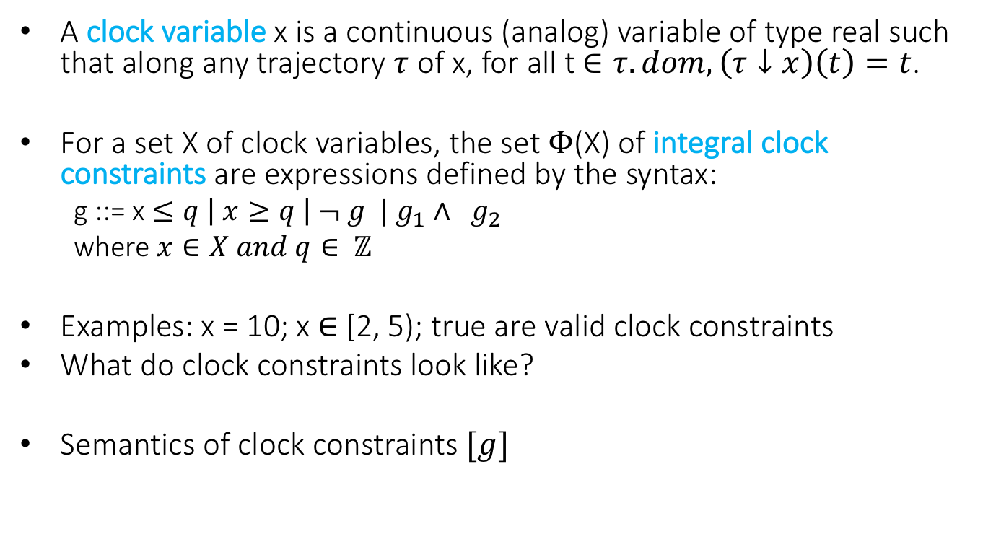
Clocks and Clock Constraints
A clock variable x is a continuous (analog) variable of type real such that along any trajectory $τ$ of x, for all t $∈τ.dom, \left(τ↓x\right)\left(t\right)=t$.
For a set X of clock variables, the set $Φ$(X) of integral clock constraints are expressions defined by the syntax:
  g ::= x $≤q \left| x≥q \right| ¬ g | g_{1}∧ g_{2}$
  where $x∈X and q∈ ℤ$
Examples: x = 10; x $∈$ [2, 5); true are valid clock constraints
What do clock constraints look like?
Semantics of clock constraints $[g]$

Slide 6
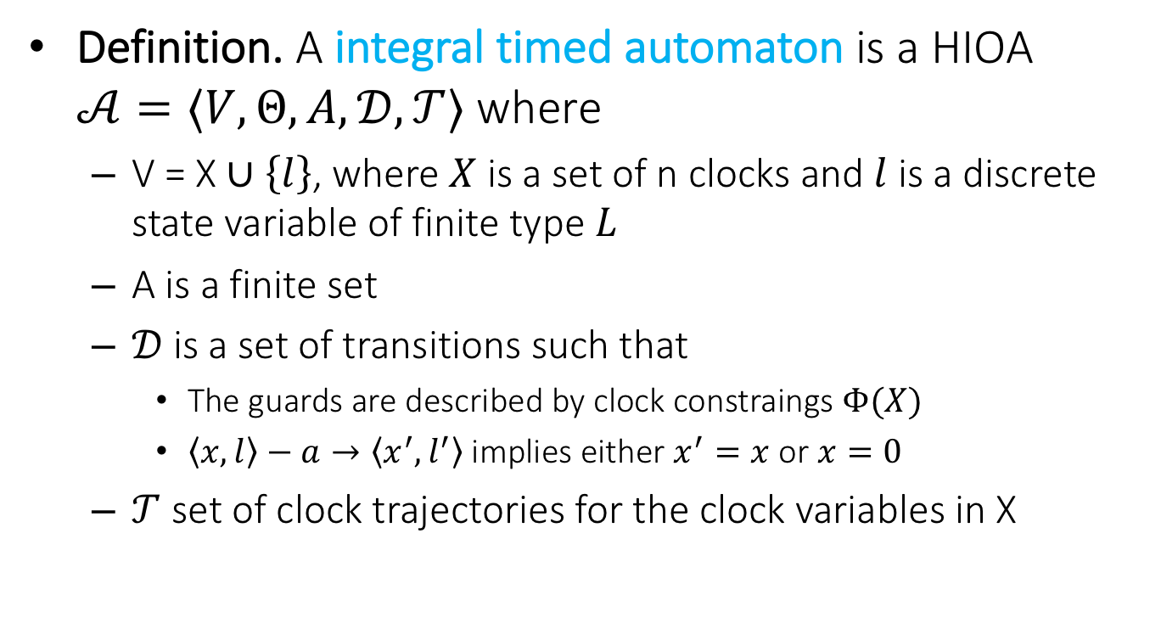
Integral Timed Automata
Definition. A integral timed automaton is a HIOA $𝒜=〈V, Θ, A, 𝒟, 𝒯〉$ where
  V = X $∪\left\{l\right\}$, where $X$ is a set of n clocks and $l$ is a discrete state variable of finite type $L$
  A is a finite set
  $𝒟$is a set of transitions such that
    The guards are described by clock constraings $Φ(X)$
    $〈x,l〉−a→〈x^{′},l^{′}〉$ implies either $x^{′}=x$ or $x=0$
  $𝒯$ set of clock trajectories for the clock variables in X

Slide 7
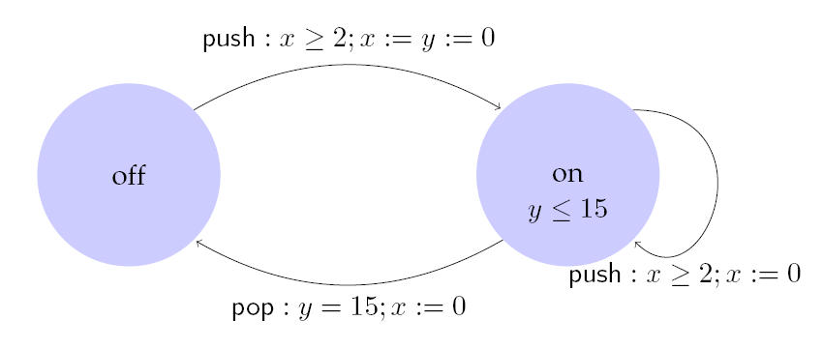
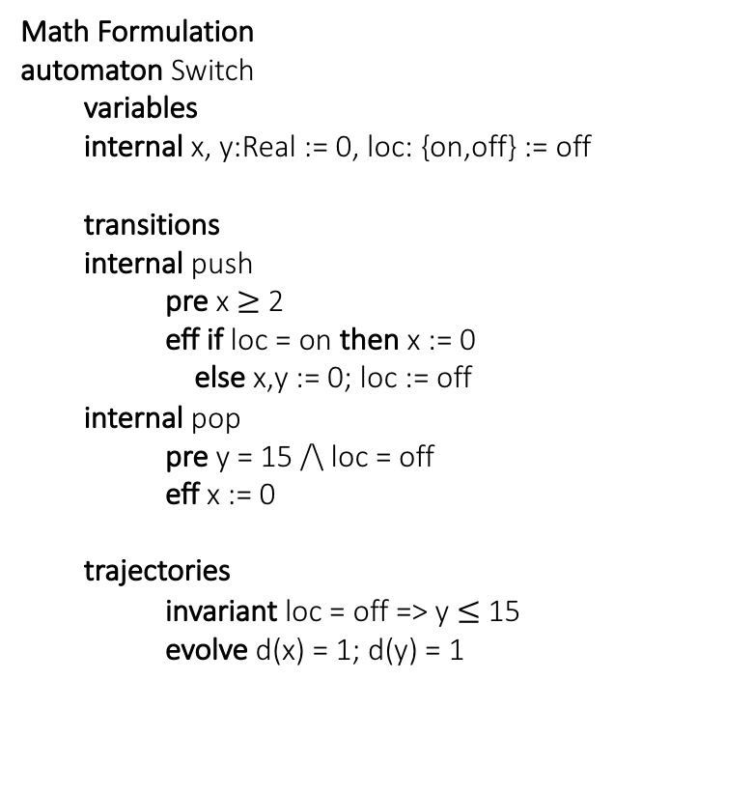
Example: Light switch
Math Formulation
automaton Switch
  variables
  internal x, y:Real := 0, loc: {on,off} := off
  transitions
  internal push
pre x $≥$ 2
eff if loc = on then x := 0
else x,y := 0; loc := off
  internal pop
pre y = 15 /\ loc = off
eff x := 0
  trajectories
invariant loc = off => y $≤$ 15
evolve d(x) = 1; d(y) = 1
Description
Switch can be turned on whenever at least 2 time units have elapsed since the last turn on. Switches off automatically 15 time units after the last on.

Slide 8
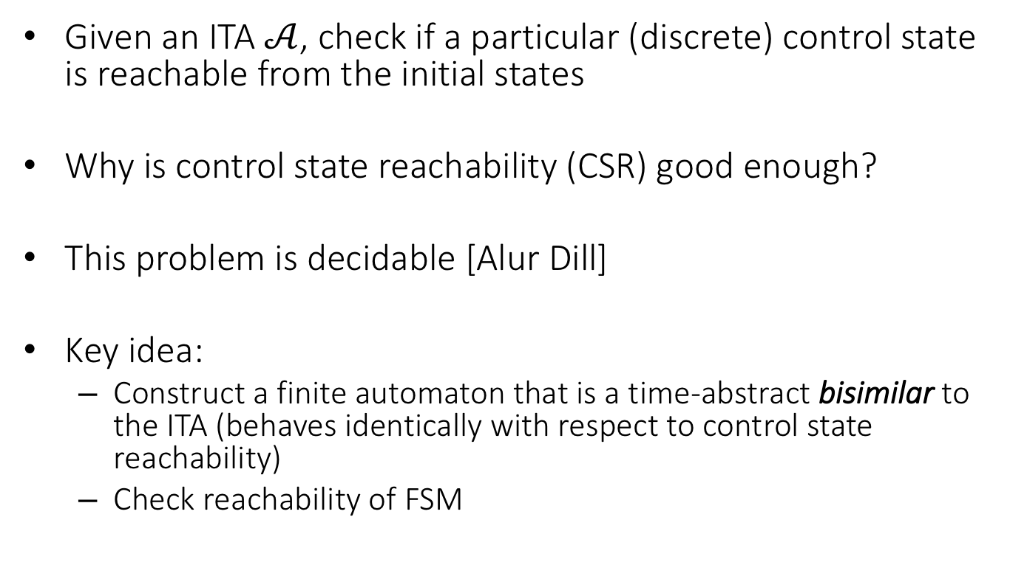
Control State (Location) Reachability Problem
Given an ITA $𝒜$, check if a particular (discrete) control state is reachable from the initial states
Why is control state reachability (CSR) good enough?
This problem is decidable [Alur Dill]
Key idea:
  Construct a finite automaton that is a time-abstract bisimilar to the ITA (behaves identically with respect to control state reachability)
  Check reachability of FSM

Slide 9
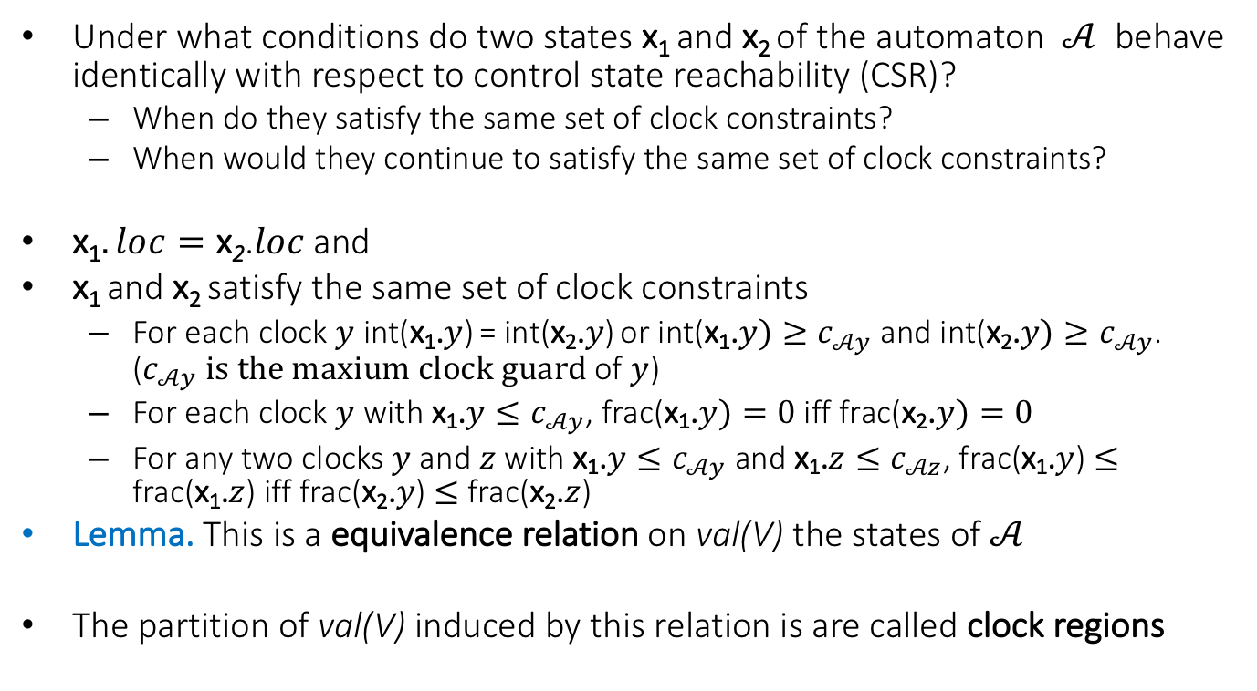
An equivalence relation with a finite quotient
Under what conditions do two states x₁ and x₂ of the automaton $𝒜$ behave identically with respect to control state reachability (CSR)?
  When do they satisfy the same set of clock constraints?
  When would they continue to satisfy the same set of clock constraints?
x₁$. loc=\text{x}\text{2}$.$loc$and
x₁ and x₂ satisfy the same set of clock constraints
  For each clock $y$ int(x₁.$y$) = int(x₂.$y$) or int(x₁.$y)≥c_{𝒜y}$and int(x₂.$y)≥c_{𝒜y}$. ($c_{𝒜y} is the maxium clock guard$ of $y$)
  For each clock $y$ with x₁.$y≤c_{𝒜y}$, frac(x₁.$y)=0$iff frac(x₂.$y)=0$
  For any two clocks $y$ and $z$ with x₁.$y≤c_{𝒜y}$ and x₁.$z≤c_{𝒜z}$, frac(x₁.$y$) $≤$ frac(x₁.$z$) iff frac(x₂.$y$) $≤$ frac(x₂.$z$)
Lemma. This is a equivalence relation on val(V) the states of $𝒜$
The partition of val(V) induced by this relation is are called clock regions

Slide 10
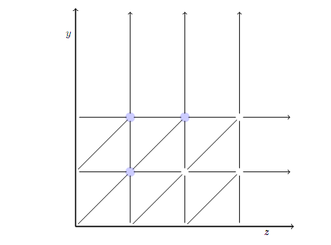
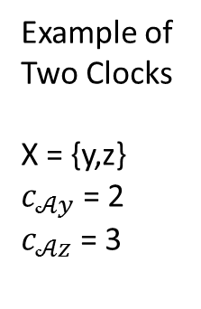
What do the clock regions look like?
Example of Two Clocks
X = {y,z}
$c_{𝒜y}$ = 2
$c_{𝒜z}$ = 3

Slide 11

Complexity
Lemma. The number of clock regions is bounded by |X|! 2^{|X|}$\prod_{z∈X}{(2c_{𝒜z}+2)}$.

Slide 12
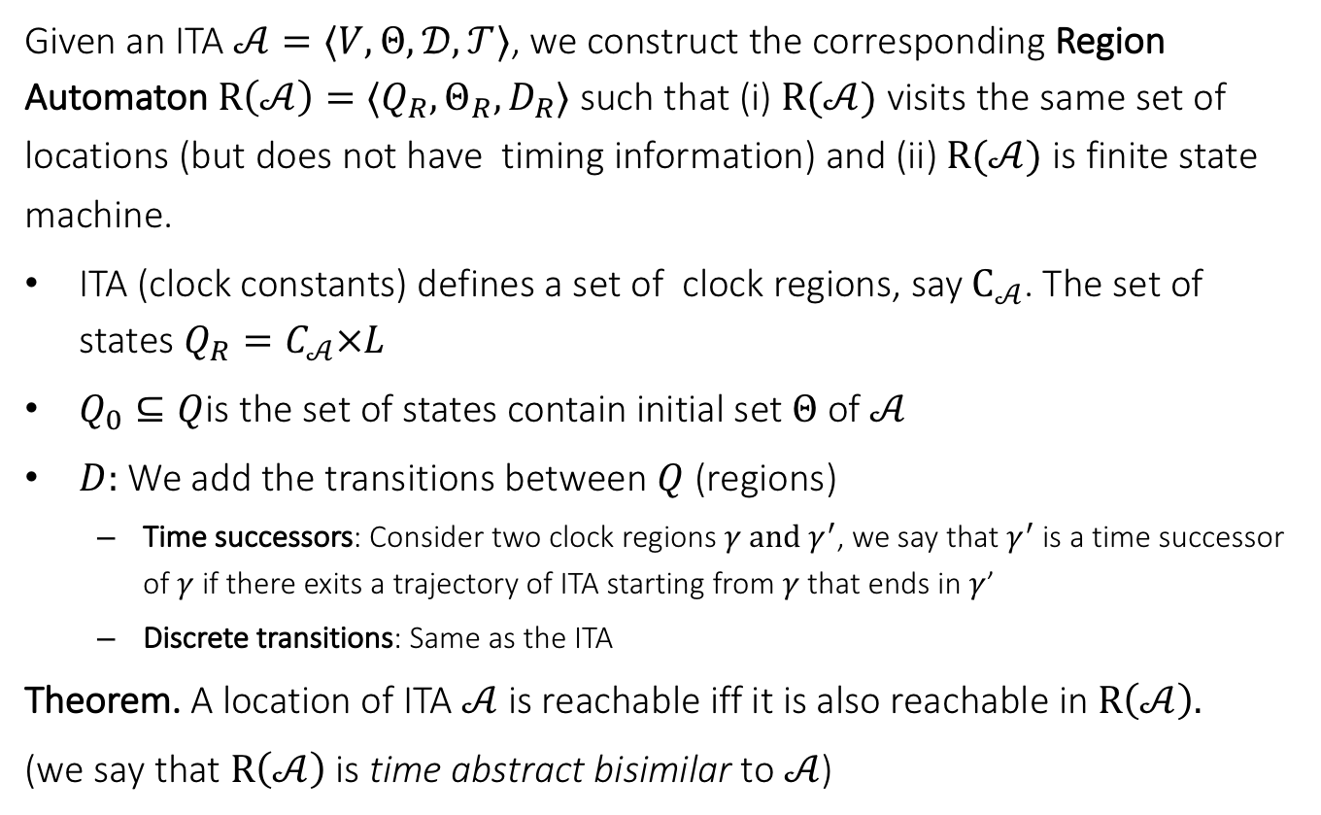

Region automaton $R(𝒜)$
Given an ITA $𝒜=〈V, Θ, 𝒟, 𝒯〉$, we construct the corresponding Region Automaton $R\left(𝒜\right)=⟨Q_{R},Θ_{R},D_{R}⟩$ such that (i) $R(𝒜)$ visits the same set of locations (but does not have timing information) and (ii) $R(𝒜)$ is finite state machine.
ITA (clock constants) defines a set of clock regions, say $C_{𝒜}$. The set of states $Q_{R}=C_{𝒜}×L$
$Q_{0}⊆Q$is the set of states contain initial set $Θ$of $𝒜$
$D:$We add the transitions between $Q$ (regions)
  Time successors: Consider two clock regions $γ and γ^{′}$, we say that $γ^{′}$ is a time successor of $γ$ if there exits a trajectory of ITA starting from $γ$ that ends in $γ$’
  Discrete transitions: Same as the ITA
Theorem. A location of ITA $𝒜$is reachable iff it is also reachable in $R\left(𝒜\right).$
(we say that $R\left(𝒜\right)$ is time abstract bisimilar to $𝒜$)

Slide 13
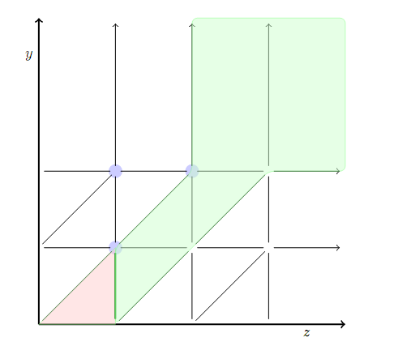
Time successors
The clock regions in blue are time successors of the clock region in red.

Slide 14

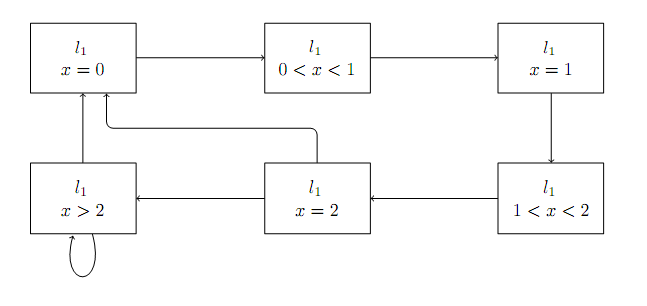
Example 1: Region Automata
ITA
Corresponding FA

Slide 15
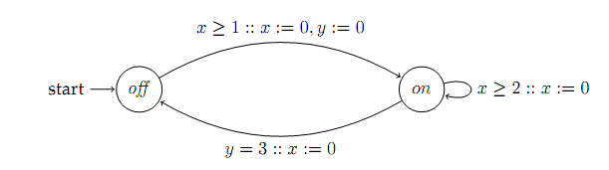
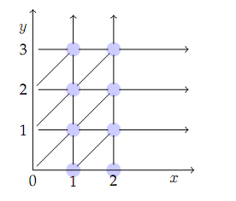
Example 2
ITA
Clock Regions

Slide 16
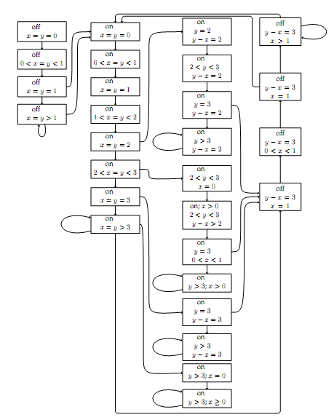
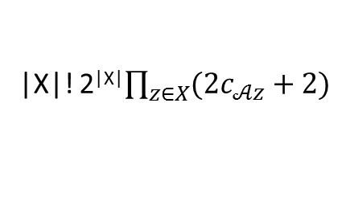
Corresponding FA
|X|! 2^{|X|}$\prod_{z∈X}{(2c_{𝒜z}+2)}$
Drastically increasing with the number of clocks

Slide 17
Special Classes of Hybrid Automata
  Timed Automata ←
  Rational time automata
  Multirate automata
  Rectangular Initialized HA
  Rectangular HA
  Linear HA
  Nonlinear HA

Slide 18
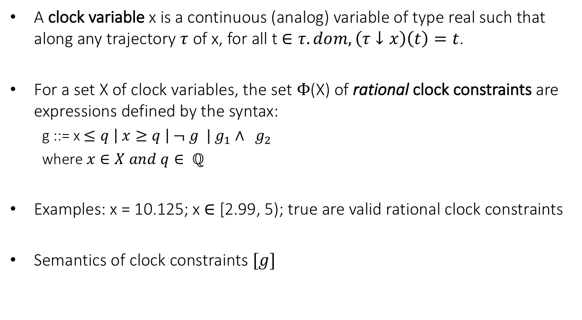
Clocks and Rational Clock Constraints
A clock variable x is a continuous (analog) variable of type real such that along any trajectory $τ$ of x, for all t $∈τ.dom, \left(τ↓x\right)\left(t\right)=t$.
For a set X of clock variables, the set $Φ$(X) of rational clock constraints are expressions defined by the syntax:
  g ::= x $≤q \left| x≥q \right| ¬ g | g_{1}∧ g_{2}$
  where $x∈X and q∈ ℚ$
Examples: x = 10.125; x $∈$ [2.99, 5); true are valid rational clock constraints
Semantics of clock constraints $[g]$

Slide 19
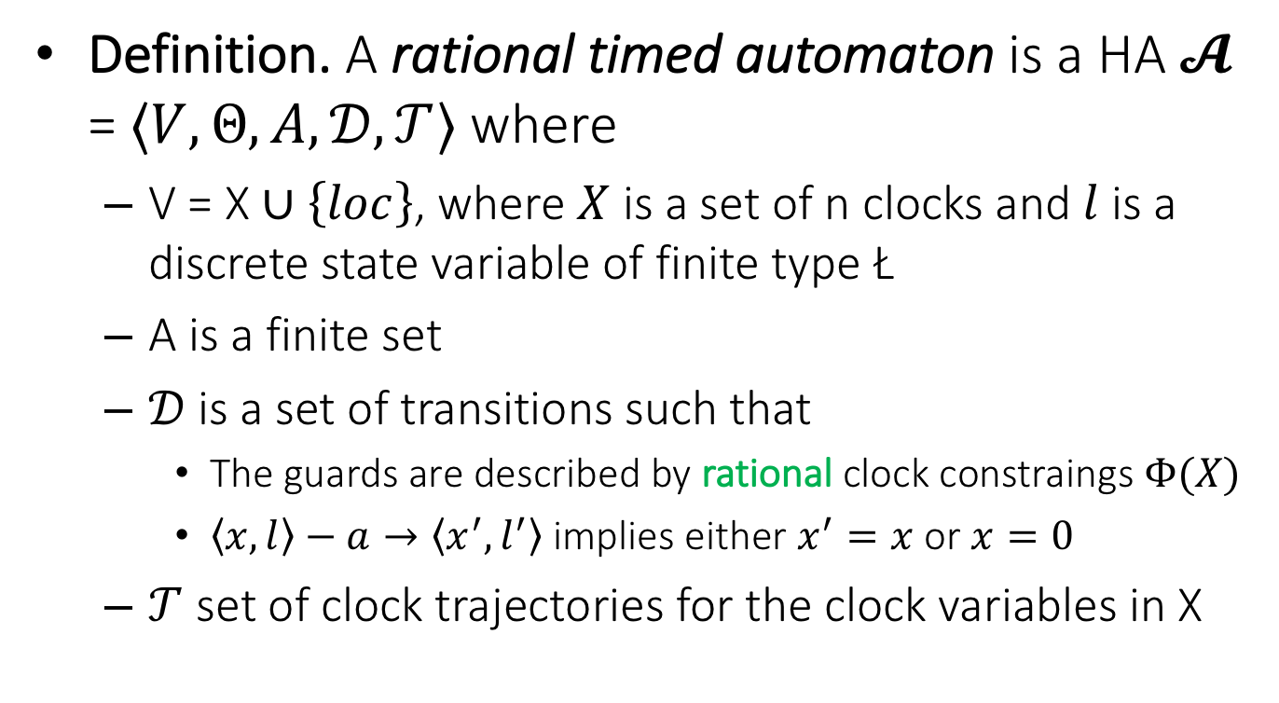
Step 1. Rational Timed Automata
Definition. A rational timed automaton is a HA $𝓐$ = $〈V, Θ, A, 𝒟, 𝒯〉$ where
  V = X $∪\left\{loc\right\}$, where $X$ is a set of n clocks and $l$ is a discrete state variable of finite type Ł
  A is a finite set
  $𝒟$is a set of transitions such that
    The guards are described by rational clock constraings $Φ(X)$
    $〈x,l〉−a→〈x^{′},l^{′}〉$ implies either $x^{′}=x$ or $x=0$
  $𝒯$ set of clock trajectories for the clock variables in X

Slide 20
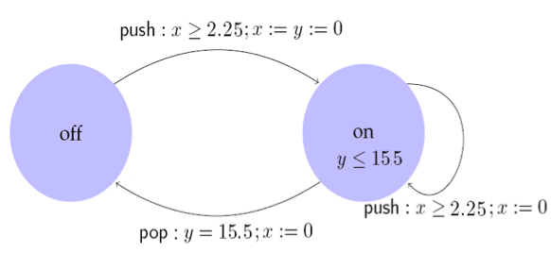

Example: Rational Light switch
Switch can be turned on whenever at least 2.25 time units have elapsed since the last turn off or on. Switches off automatically 15.5 time units after the last on.
automaton Switch
internal push; pop
variables
internal x, y:Real := 0, loc:{on,off} := off
transitions
push
pre x >=2.25
eff if loc = on then y := 0 fi; x := 0; loc := off
pop
pre y = 15.5 $∧$ loc = off
eff x := 0
trajectories
invariant loc = on $∨$ loc = off
stop when y = 15.5 $∧$ loc = off
evolve d(x) = 1; d(y) = 1

Slide 21
Control State (Location) Reachability Problem
Given an RTA, check if a particular location is reachable from the initial states
Is problem decidable?
Yes
Key idea:
  Construct a ITA that is time-abstract bisimilar to the given RTA
  Check CSR for ITA

Slide 22


Construction of ITA from RTA
Multiply all rational constants by a factor q that make them integral
Make d(x) = q for all the clocks
RTA Switch is bisimilar to ITA Iswitch
Simulation relation R is given by
(u,s) $∈R$iff u.x = 4 s.x and u.y = 4 s.y
automaton ISwitch
internal push; pop
variables
internal x, y:Real := 0, loc:{on,off} := off
transitions
push
pre x >= 9
eff if loc = on then y := 0 fi; x := 0; loc := off
pop
pre y = 62 $∧$ loc = off
eff x := 0
trajectories
invariant loc = on $∨$ loc = off
stop when y = 62 $∧$ loc = off
evolve d(x) = 4; d(y) = 4

Slide 23
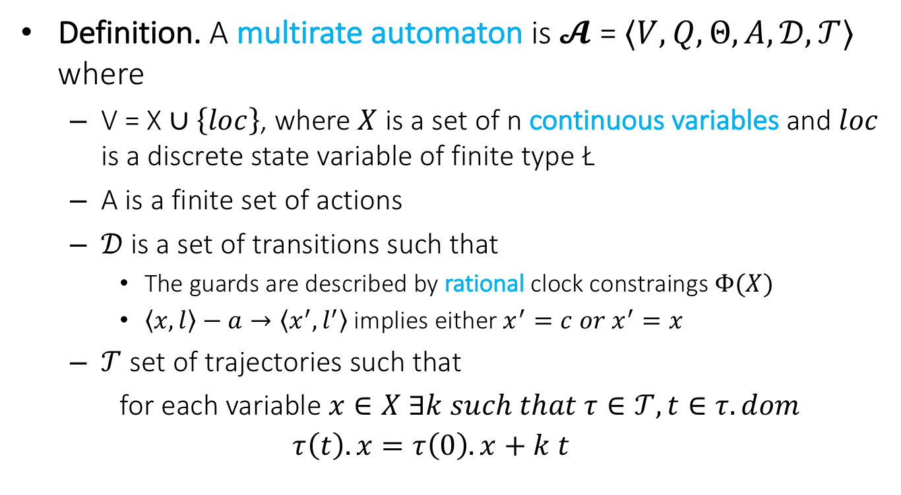
Step 2. Multi-Rate Automaton
Definition. A multirate automaton is $𝓐$ = $〈V, Q, Θ, A, 𝒟, 𝒯〉$ where
  V = X $∪\left\{loc\right\}$, where $X$ is a set of n continuous variables and $loc$ is a discrete state variable of finite type Ł
  A is a finite set of actions
  $𝒟$is a set of transitions such that
    The guards are described by rational clock constraings $Φ(X)$
    $〈x,l〉−a→〈x^{′},l^{′}〉$ implies either $x^{′}=c{ or x}^{′}=x$
  $𝒯$ set of trajectories such that
  for each variable $x∈X ∃k such that τ∈𝒯, t∈τ.dom$
  $$τ\left(t\right).x=τ\left(0\right).x+k t$$

Slide 24
Control State (Location) Reachability Problem
Given an MRA, check if a particular location is reachable from the initial states
Is problem is decidable? Yes
Key idea:
  Construct a RTA that is bisimilar to the given MRA

Slide 25
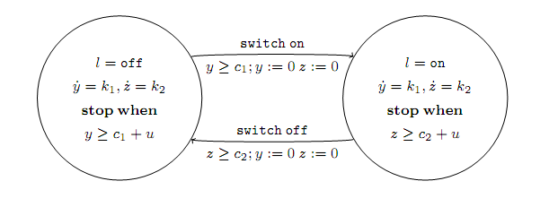
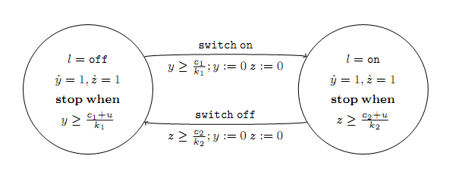
Example: Multi-rate to rational TA

Slide 26
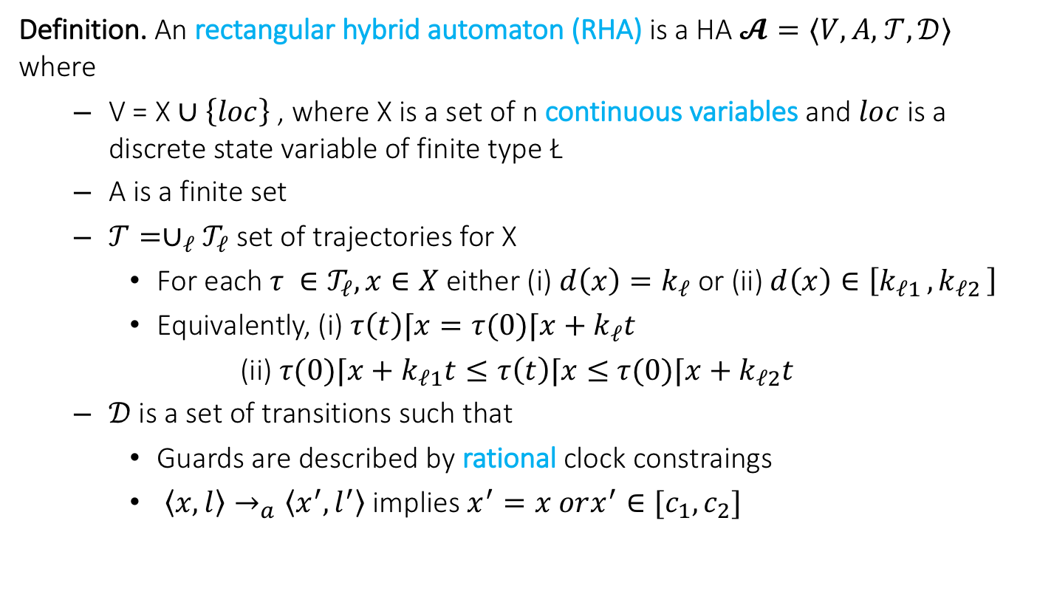
Step 3. Rectangular HA
Definition. An rectangular hybrid automaton (RHA) is a HA $𝓐=⟨V,A,$ $𝒯,𝒟⟩$ where
  V = X $∪\left\{loc\right\}$ , where X is a set of n continuous variables and $loc$ is a discrete state variable of finite type Ł
  A is a finite set
  $𝒯={∪_{ℓ}𝒯}_{ℓ}$ set of trajectories for X
    For each $τ ∈𝒯_{ℓ}, x∈X$ either (i) $d\left(x\right)=k_{ℓ}$ or (ii) $d\left(x\right)∈\left[k_{ℓ1 },k_{ℓ2 }\right]$
    Equivalently, (i) $τ\left(t\right)⌈x=τ(0)⌈x+k_{ℓ}t$
    (ii) $τ(0)⌈x+k_{ℓ1}t≤τ\left(t\right)⌈x≤$ $τ(0)⌈x+k_{ℓ2}t$
  $𝒟$is a set of transitions such that
    Guards are described by rational clock constraings
    $〈x,l〉→_{a}〈x^{′},l^{′}〉$ implies $x^{′}=x orx^{′}∈[c_{1},c_{2}]$

Slide 27
CSR Decidable for RHA?
Given an RHA, check if a particular location is reachable from the initial states?
Is this problem decidable? No
  [Henz95] Thomas Henzinger, Peter Kopke, Anuj Puri, and Pravin Varaiya. What's Decidable About Hybrid Automata?. Journal of Computer and System Sciences, pages 373–382. ACM Press, 1995.
  CSR for RHA reduction to Halting problem for 2 counter machines
  Halting problem for 2CM known to be undecidable
  Reduction in next lecture

Slide 28
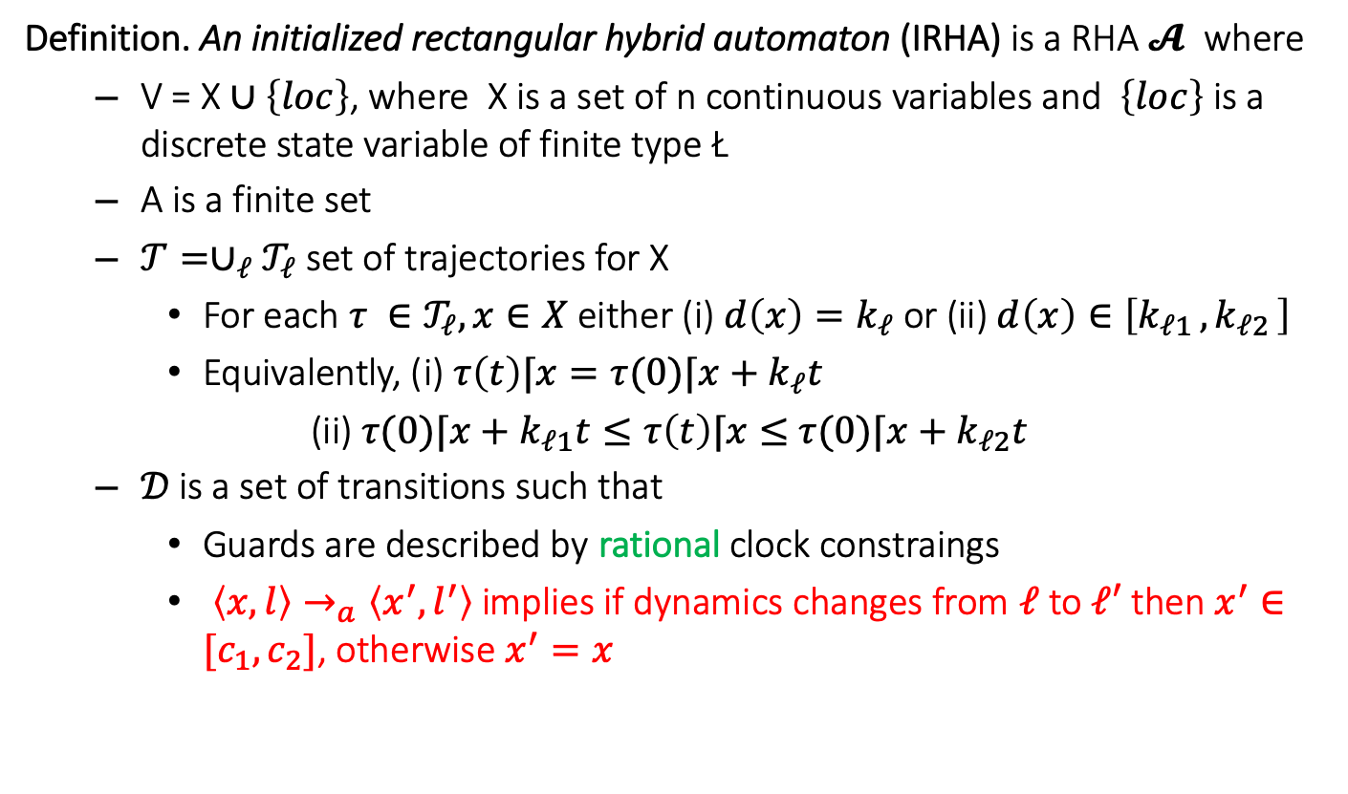
Step 4. Initialized Rectangular HA
Definition. An initialized rectangular hybrid automaton (IRHA) is a RHA $𝓐$ where
  V = X $∪\left\{loc\right\}$, where X is a set of n continuous variables and $\left\{loc\right\}$ is a discrete state variable of finite type Ł
  A is a finite set
  $𝒯={∪_{ℓ}𝒯}_{ℓ}$ set of trajectories for X
    For each $τ ∈𝒯_{ℓ}, x∈X$ either (i) $d\left(x\right)=k_{ℓ}$ or (ii) $d\left(x\right)∈\left[k_{ℓ1 },k_{ℓ2 }\right]$
    Equivalently, (i) $τ\left(t\right)⌈x=τ(0)⌈x+k_{ℓ}t$
    (ii) $τ(0)⌈x+k_{ℓ1}t≤τ\left(t\right)⌈x≤$ $τ(0)⌈x+k_{ℓ2}t$
  $𝒟$is a set of transitions such that
    Guards are described by rational clock constraings
    $〈x,l〉→_{a}〈x^{′},l^{′}〉$ implies if dynamics changes from $ℓ$ to $ℓ′$ then $x^{′}∈[c_{1},c_{2}]$, otherwise $x^{′}=x$

Slide 29
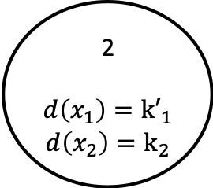

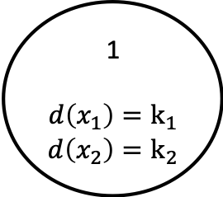
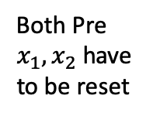
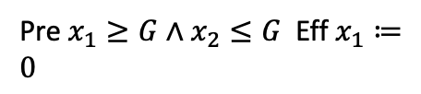
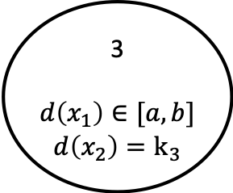
Example: Rectangular Initialized HA
Pre $x_{1}≥G∧x_{2}≤G$ Eff $x_{1}≔0$
1
$$d\left(x_{1}\right)=k_{1}$$
$$d\left(x_{2}\right)=k_{2}$$
2
$$d\left(x_{1}\right)={k′}_{1}$$
$$d\left(x_{2}\right)=k_{2}$$
Both Pre $x_{1}, x_{2}$ have to be reset
3
$$d\left(x_{1}\right)∈[a,b]$$
$$d\left(x_{2}\right)=k_{3}$$
Eff $x_{1}, x_{2}∈[c,d]$

Slide 30
CSR Decidable for IRHA?
Given an IRHA, check if a particular location is reachable from the initial states
Is this problem decidable? Yes
Key idea:
  Construct a 2n-dimensional initialized multi-rate automaton that is bisimilar to the given IRHA
  Construct a ITA that is bisimilar to the Singular TA

Slide 31
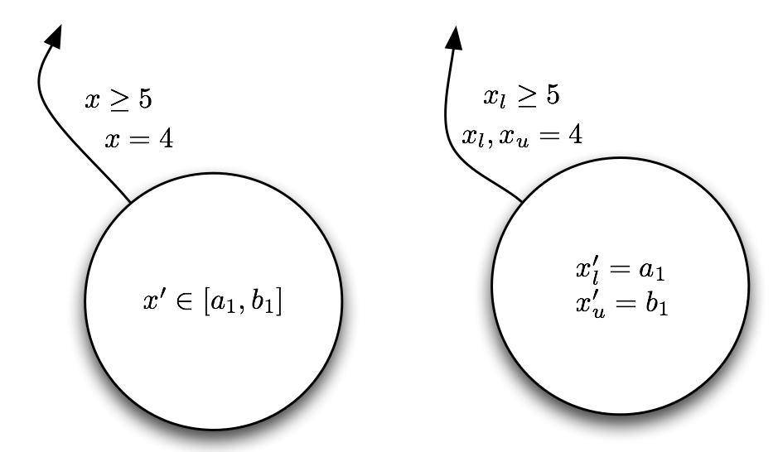
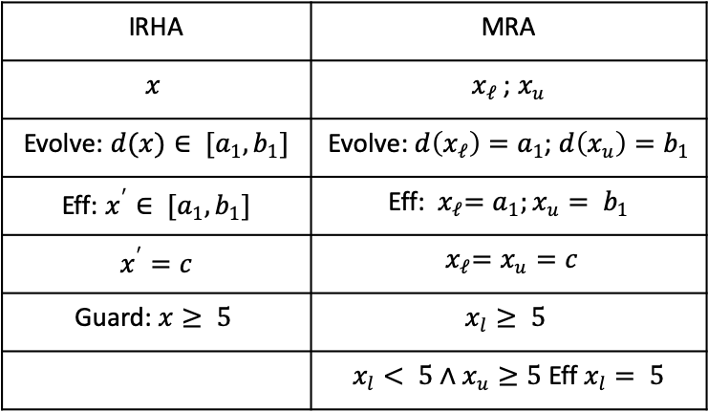
From IRHA to Singular HA conversion
For every variable create two variables---tracking the upper and lower bounds
IRHA | MRA
$$x$$ | $x_{ℓ}$ ; $x_{u}$
Evolve: $d(x)∈ [a_{1},b_{1}]$ | Evolve: $d\left(x_{ℓ}\right)=a_{1}$; $d\left(x_{u}\right)=b_{1}$
Eff: $x^{′}∈ [a_{1},b_{1}]$ | Eff:${ x}_{ℓ}=a_{1};x_{u}= b_{1}$
$x^{′}=c$ | $${ x}_{ℓ}=x_{u}=c$$
Guard: $x≥ 5$ | $$x_{l}≥ 5$$
 | $x_{l}< 5∧x_{u}≥5$ Eff $x_{l}= 5$

Slide 32
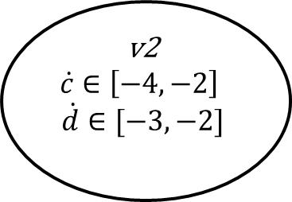
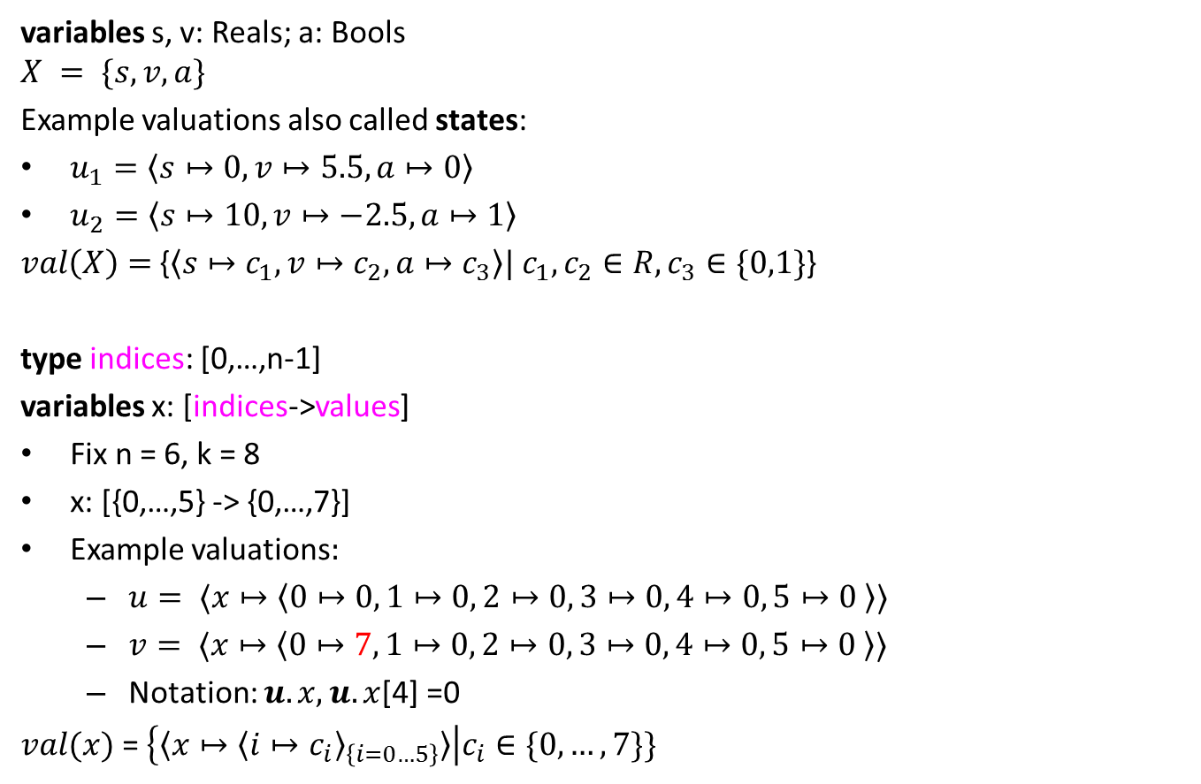
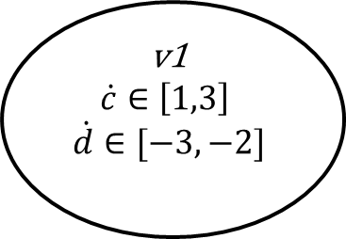
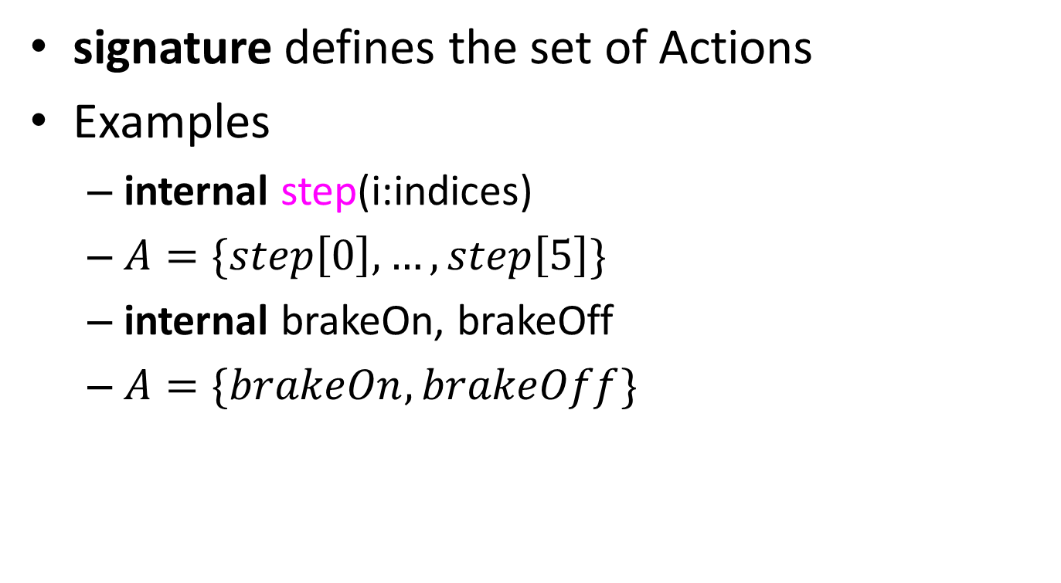
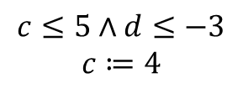
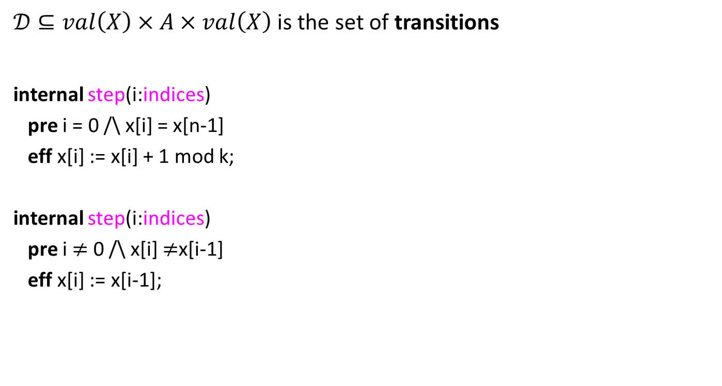

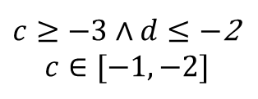
Example IRHA
$$c≔0;d≔1$$
v1
$$\dot{c}∈\left[1,3\right]$$
$$\dot{d}∈[−3,−2]$$
$c≥0∧d≤$2
$$d≔1$$
v4
$$\dot{c}∈\left[1,3\right]$$
$$\dot{d}∈[1,2]$$
$$c≤5∧d≤−3$$
$$c≔4$$
$c≥−3∧d≤−$2
$$c∈[−1,−2]$$
v2
$$\dot{c}∈\left[−4,−2\right]$$
$$\dot{d}∈[−3,−2]$$
$$d≤−5$$
$$d≔−4$$
v3
$$\dot{c}∈\left[−4,−2\right]$$
$$\dot{d}∈[1,2]$$

Slide 33
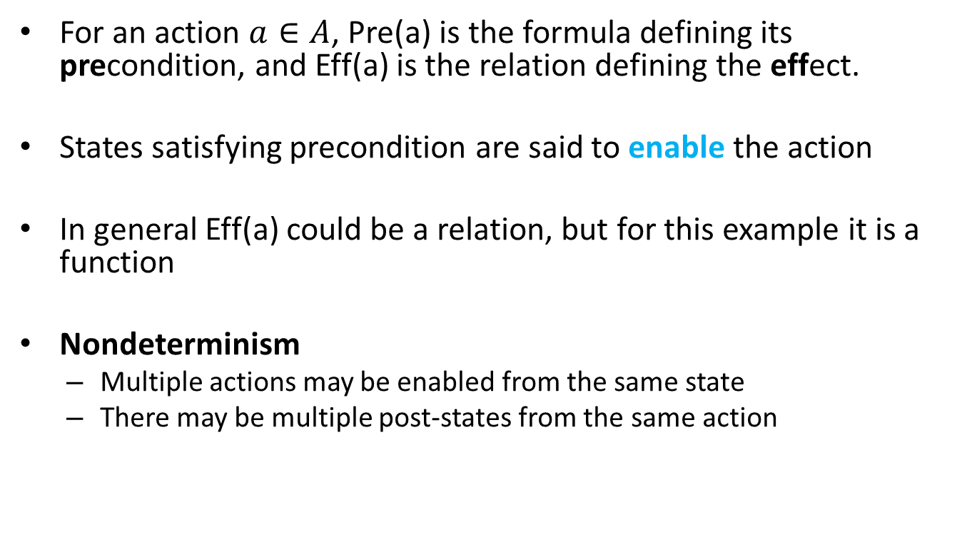
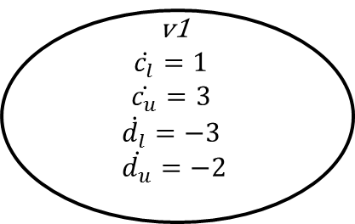
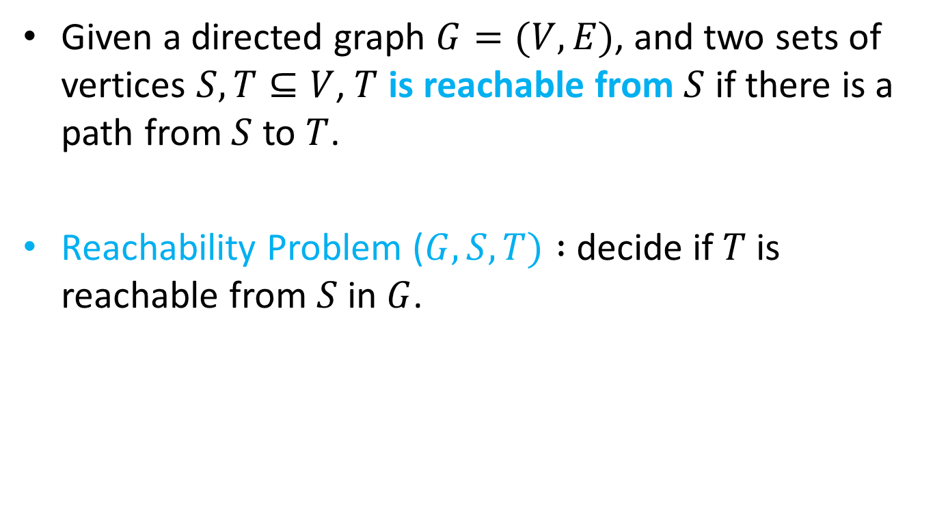
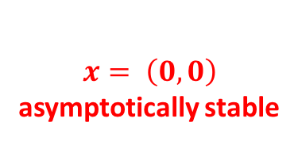
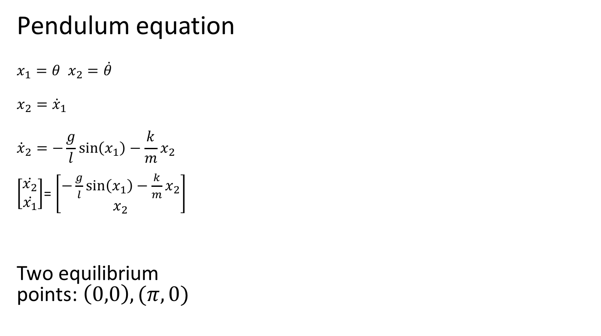
Initialized Singular HA
$$c_{l},c_{u}≔0;d_{l}, d_{u}≔1$$
v1
$$\dot{c_{l}}=1$$
$$\dot{c_{u}}=3$$
$$\dot{d_{l}}=−3$$
$$\dot{d_{u}}=−2$$
v4
$\dot{\begin{aligned}\dot{c_{l}}=1 \\ \dot{c_{u}}=3 \\ \begin{aligned} \dot{d_{l}}=1 \\ \dot{d_{u}}=2 \end{aligned}\end{aligned}}$
v2
$$\dot{\begin{aligned}\dot{c_{l}}=−4 \\ \dot{c_{u}}=−2 \\ \begin{aligned} \dot{d_{l}}=−3 \\ \dot{d_{u}}=−2 \end{aligned}\end{aligned}}$$
v3
$$\dot{\begin{aligned}\dot{c_{l}}=−4 \\ \dot{c_{u}}=−2 \\ \begin{aligned} \dot{d_{l}}=1 \\ \dot{d_{u}}=2 \end{aligned}\end{aligned}}$$

Slide 34
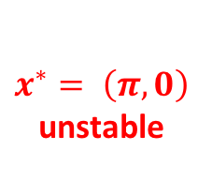
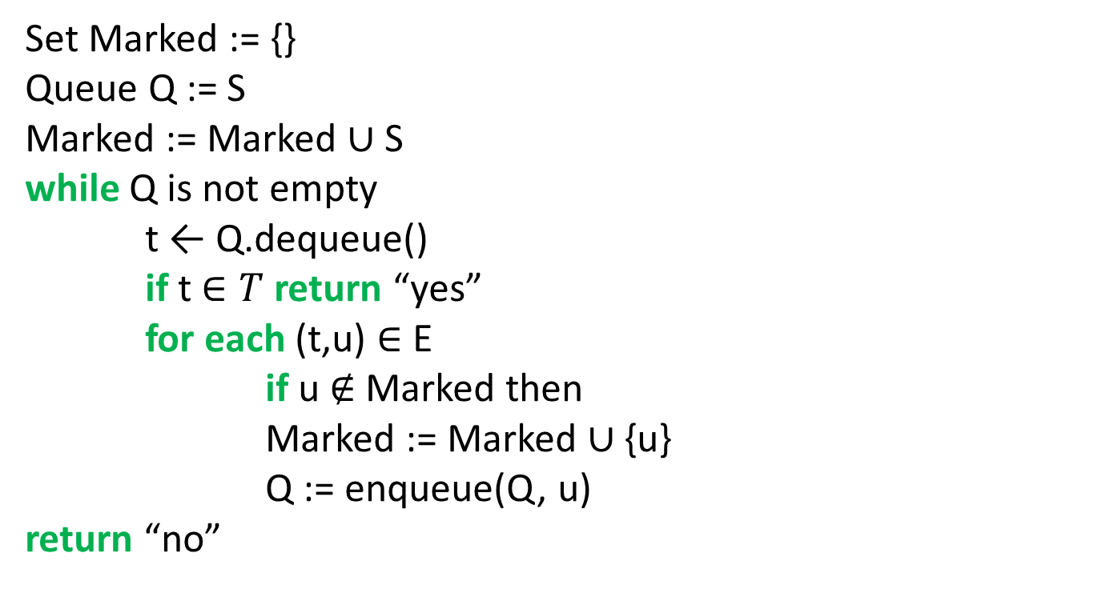
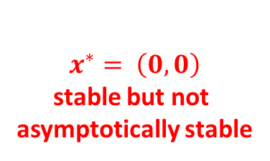
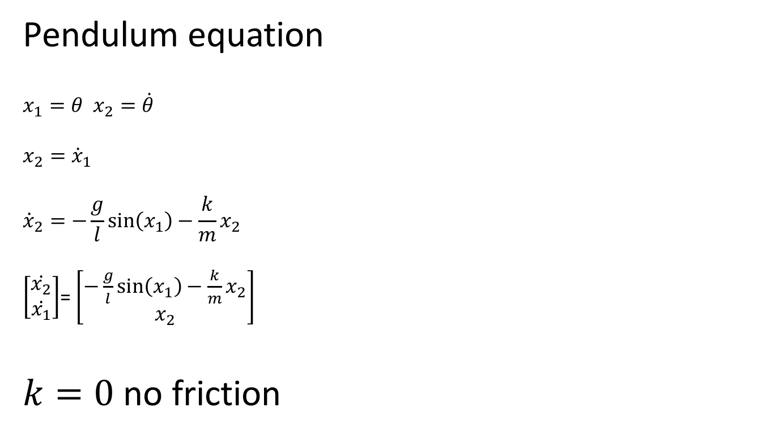
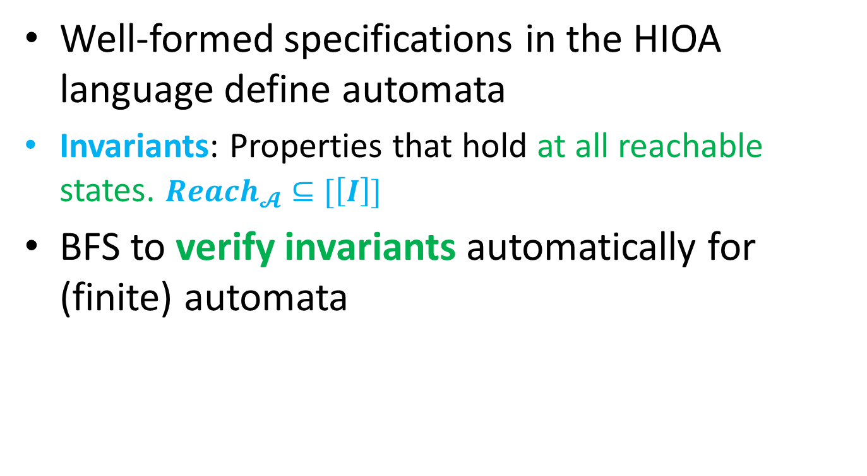
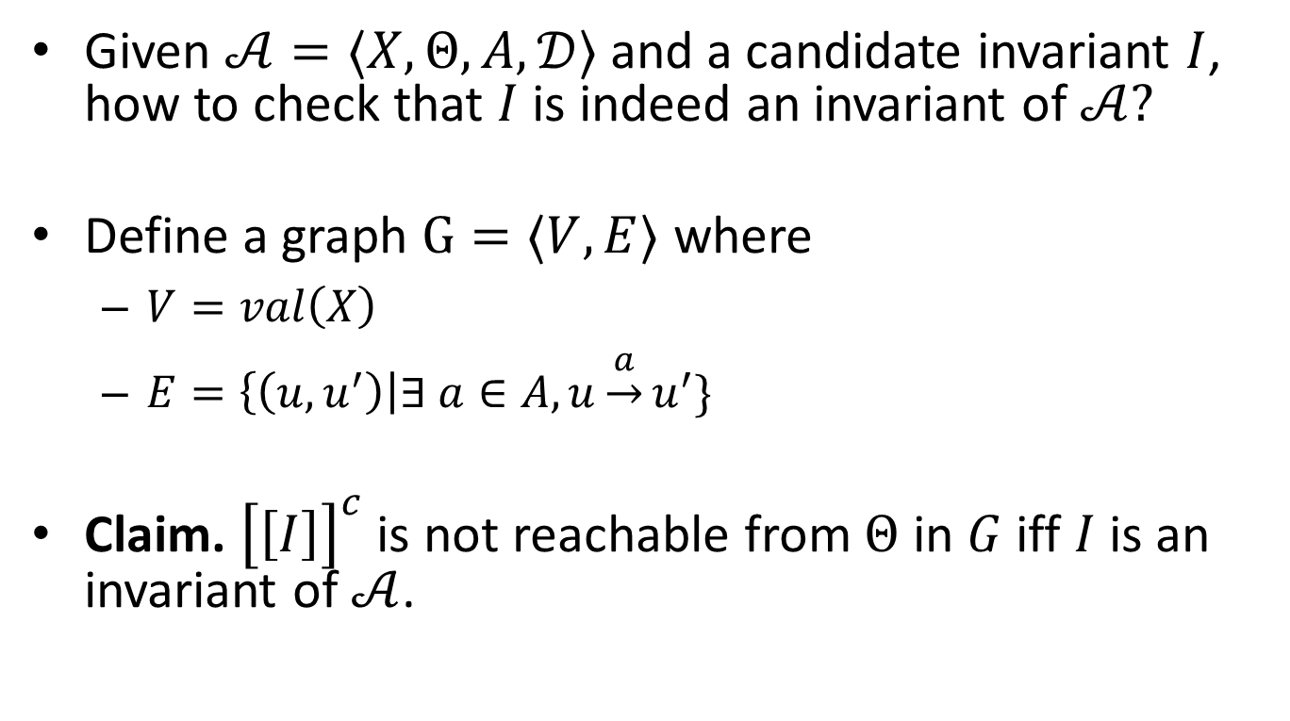
Transitions
v1
$$\dot{c_{l}}=1$$
$$\dot{c_{u}}=3$$
$$\dot{d_{l}}=−3$$
$$\dot{d_{u}}=−2$$
5
$$c_{u}$$
$$c_{l}$$
$$c_{l}≤5$$
$$c_{l}, c_{u}≔4$$
$d_{u}≤−3$ no reset
$d_{u}>−3∧d_{l}≤−3 d_{u}≔$-3
$${d_{u}}_{ }$$
-3
$$d_{l}$$

Slide 35
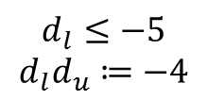




Initialized Singular HA
$$c_{l},c_{u}≔0;d_{l}, d_{u}≔1$$
v1
$$\dot{c_{l}}=1$$
$$\dot{c_{u}}=3$$
$$\dot{d_{l}}=−3$$
$$\dot{d_{u}}=−2$$
$c_{l}≥0∧d_{l}≤$2
$$d_{l}, d_{u}≔1$$
v4
$\dot{\begin{aligned}\dot{c_{l}}=1 \\ \dot{c_{u}}=3 \\ \begin{aligned} \dot{d_{l}}=1 \\ \dot{d_{u}}=2 \end{aligned}\end{aligned}}$
$c_{l}<0∧c_{u}≥0∧d_{l}≤$2
$$c_{l}≔0d_{l}, d_{u}≔1$$
$$c_{l}≤5∧d_{u}≤−3$$
$$c_{l}, c_{u}≔4$$
$$c_{l}≤5∧d_{l}≤−3∧d_{u}>−3$$
$$c_{l}, c_{u}≔4 d_{u}≔−3$$
$c_{u}≥−3∧d_{u}≤−$2
$$c_{l}≔−2c_{u}≔−1$$
$c_{u}≥−3∧d_{l}≤−2 ∧d_{u}>−2$
$$c_{l}≔−2c_{u}≔−1 d_{u}−2$$
v2
$$\dot{\begin{aligned}\dot{c_{l}}=−4 \\ \dot{c_{u}}=−2 \\ \begin{aligned} \dot{d_{l}}=−3 \\ \dot{d_{u}}=−2 \end{aligned}\end{aligned}}$$
$$d_{l}≤−5$$
$$d_{l}d_{u}≔−4$$
v3
$$\dot{\begin{aligned}\dot{c_{l}}=−4 \\ \dot{c_{u}}=−2 \\ \begin{aligned} \dot{d_{l}}=1 \\ \dot{d_{u}}=2 \end{aligned}\end{aligned}}$$

Slide 36
Can this be further generalized ?
For initialized Rectangular HA, control state reachability is decidable
  Can we drop the initialization restriction?
    No, problem becomes undecidable (next time)
  Can we drop the rectangular restriction?
    No, problem becomes undecidable

Slide 37


Verification in tools

Slide 38

Data structures make reachability go around
Hyperrectangles
  $\left[\left[g_{1};g_{2}\right]\right]=\left\{x∈R^{n} \right|{ \left|\left|x−g_{1}\right|\right|}_{ _{∞}}≤{\left|\left|g_{2}−g_{1}\right|\right|}_{ _{∞}}\}=Π_{i}[g_{1i},g_{2i}]$
Polyhedra
Zonotopes [Girard 2005]
Ellipsoids [Kurzhanskiy 2001]
Support functions [Guernic et al. 2009]
Generalized star set [Duggirala and Viswanathan 2018]

Slide 39
Data structures: rectangles and ellipsoids

Slide 40
Zonotopes and polytopes

Slide 41
Summary
ITA: Restricted class of hybrid automata
  Clocks, integer constraints
  No clock comparison, linear
Control state reachability with Alur-Dill’s algorithm (region automaton construction)
Rational coefficients; multirate Automata
Initialized Rectangular Hybrid Automata
HyTech, PHAVer use polyhedral reachability computations
Notes:
fix-point implementation in tools
We can remove the init. set. Hytech will accept the automaton, but there is no guarantee on termination

