Slide 1
Data-driven verification
C2E2 and DryVR
Electrical & Computer Engineering
Coordinated Science Laboratory
University of Illinois at Urbana Champaign
ECE 584

Slide 2
Safety verification problem
System S requirement R
Algorithm
Bug trace
Certificate
Is there a behavior of system S violating safety requirement R within time bound T?
Yes -> bug-trace -> design improvement
No -> safety proof -> certification
Notes:
-2 setting stage

Slide 3
Safety verification problem
System S requirement R
Bug trace
Dry R
Certificate
Is there a behavior of system S violating safety requirement R within time bound T?
Yes -> bug-trace -> design improvement
No -> safety proof -> certification
Notes:
-2 setting stage

Slide 4
Recall: timed automata
guard
$$y≥3$$
$$y=0$$
reset/affection
dynamic
$$x=0$$
$$y=0$$
$$\dot{x}=1$$
$$\dot{y}=1$$
$$y≤5$$
$$\dot{x}=1$$
$$\dot{y}=1$$
$$y≤10$$
$$x≤8$$
invariant
$$y≥4∧x≥6$$
$$x=0$$

Slide 5
Recall: bouncing ball
dynamic: general nonlinear function
guard
$$y=h$$
$$v=0$$
$$\dot{y}=v$$
$$\dot{v}=−g$$
$$y,v≥0$$
$$y≤0∧v≤0$$
$$v=−cv$$
reset/affection
invariant

Slide 6
Recall: bouncing ball
$$y=h$$
$$v=0$$
$$\dot{y}=v$$
$$\dot{v}=−g$$
$$\dot{t}=1$$
$$y,v≥0$$
$$y≤0∧v≤0∧t≥ε$$
$$v=−cv∧t=0$$
Avoid the Zeno behavior

Slide 7
Summary of C2E2
Input: hyxml file
Properties: initial set + unsafe set
Simulate and/or verification
Plotter

Slide 8
Outline
Introduction and C2E2 demo
Model-based sensitivity
Simulation-driven verification algorithm
Discrepancy function
Matrix measure and sensitivity
More examples
Next lecture on Thursday:
New modeling questions with DryVR

Slide 9
System models and notations
nonlinear dynamical model
$$\dot{x}\left(t\right)=f\left(x\left(t\right)\right)$$
$$Θ,U⊆ℝ^{n}$$
$ξ(Θ,[0,T])$: reach set
$$x_{0}$$
$ξ(x_{0},t)$: trajectory
time
Safety verification problem $ξ\left(Θ,\left[0,T\right]\right)∩U=∅?$
Notes:
3 setting up notation
\xi with sets

Slide 10
Simulations to safety proofs
Given start and target
Compute finite cover $∪_{i}B\left(x_{i},δ\right)⊇Θ$
Simulate from the center $x_{0}$ of each cover to get $ξ\left(x_{0},\{t_{1},…,t_{k}\}\right)$
Bloat simulation so that
$ξ\left(x_{0},.\right)⊕β$ $⊇ξ\left({B(x}_{0},δ),[0,T]\right)$
Check intersection/containment with $U$
Refine cover if needed and repeat …
How to bloat or generalize simulations?
$$U$$
$$Θ$$
Notes:
4 Algorithm
5 Algorithm

Slide 11
Brief history
2000 | On Systematic Simulation of Open Continuous Systems | Kapinski et al.
2006 | Verification using simulation | Girard and Pappas
2007 | Robust Test Generation and Coverage for Hybrid Systems | Julius, Fainekos, et al.
2010 | Breach, a toolbox for verification and parameter synthesis of hybrid systems. | Donzé
2013 | Verification of annotated models from executions. | Duggirala, Mitra, Viswanathan
Notes:
6

Slide 12
Main problem: How to quantify generalization?
Discrepancy formalizes generalization :
Discrepancy is a continuous function $β$ that bounds the distance between neighboring trajectories
$\left\|ξ\left(x_{1},t\right)−ξ(x_{2},t)\right\|≤β\left(\left\|x_{1}−x_{2}\right\|,t\right)$,
From a single simulation of $ξ(x_{1}, t)$and discrepancy $β$ we can over-approximate the reachtube
$$ξ\left(x_{2},t\right)$$
$$x_{2}$$
$$x_{1}$$
$$β(‖x_{1}−x_{2}‖,t)$$
$$ξ\left(x_{1},t\right)$$
Notes:
Sayan: Emphasize that \beta is now known and in a moment you are going to tell us how to get it.

Slide 13
A simple example of discrepancy function
If $f(x)$has a Lipschitz constant $L$:
$$∀x,y∈ℝ^{n}, \left\|f\left(x\right)−f\left(y\right)\right\|≤L\left\|x−y\right\|$$
Example: $\dot{x}=−2x,$Lipschitz constant $L=2$
then a (bad) discrepancy function is
$$\left\|ξ\left(x_{1},t\right)−ξ(x_{2},t)\right\|≤\left\|x_{1}−x_{2}\right\|e^{Lt}=β\left(\left\|x_{1}−x_{2}\right\|,t\right)$$
$$ξ\left(x_{2},t\right)$$
$$x_{2}$$
$$x_{1}$$
$$β(‖x_{1}−x_{2}‖,t)$$
$$ξ\left(x_{1},t\right)$$

Slide 14
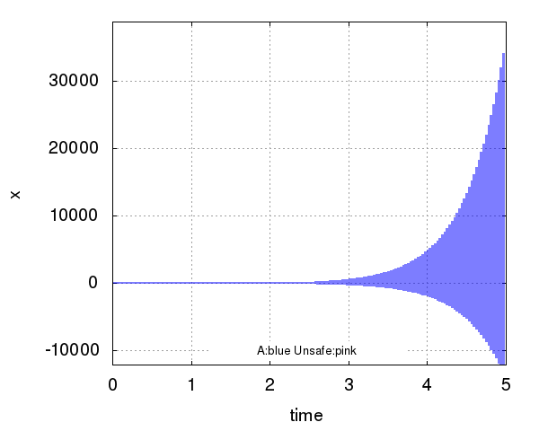
A simple example of discrepancy function
$$ξ\left(x_{2},t\right)$$
$$x_{2}$$
$$x_{1}$$
$$β(‖x_{1}−x_{2}‖,t)$$
$$ξ\left(x_{1},t\right)$$
$\dot{x}=−2x,$Lipschitz constant $L=2, δ=1$

Slide 15
What is a good discrepancy ?
General: Applies to general nonlinear $f$
Accurate: Small error in $β$
Effective: Computing $β$is fast (in practice)
$$ξ\left(x_{2},t\right)$$
$$x_{2}$$
$$x_{1}$$
$$β(‖x_{1}−x_{2}‖,t)$$
$$ξ\left(x_{1},t\right)$$
Notes:
(results not going to improve asymptotic complexity bounds of these algorithms that I have dev. but the alg are based on solving optimization probs (SDP) which are well known to be .. and comparing the computational effort needed we compare the size of these resulting opt problems.
Sayan: For each of the 3 bullets highlight what it means in practice (for the cars, e.g.)
General “means we can handle more complex and realistic models of the cars”
Accurate “translates to (a) faster verification of the control algorithm, and (b) also less conservative designs can be proved correct”
Effective “also means faster, but .. “ then the statement above about complexity.
-> It may be worth adding some of these words as subbullets in the slide

Slide 16
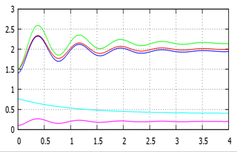
Discrepancy quantifies sensitivity
$$ξ\left({B(x}_{0},δ),[0,T]\right) ⊆ ξ\left(x_{0},.\right)⊕β$$
reach set over-approximated by simulation and sensitivity
Definition. $β:ℝ^{2n}×ℝ^{≥0}→$ $ℝ^{≥0 }$defines a discrepancy of the system if for any two states $x_{1}$ and $x_{2}∈X$, for any t,
$|ξ\left(x_{1},t\right)−ξ\left(x_{2},t\right)|≤β\left(x_{1},x_{2},t\right)$ and
$β→0$as $x_{1}→x_{2}$
$$−ξ\left(x_{1},t\right)$$
$$−V\left(ξ\left(x_{1},t\right),ξ\left(x_{2},t\right)\right)$$
$$−β\left(x_{1},x_{2},t\right)$$
Notes:
7 definition; 2 parts soundness & completeness

Slide 17
Computing discrepancy
$$\left|ξ\left(x_{1},t\right)−ξ\left(x_{2},t\right)\right|≤e^{Lt}\left|x_{1}−x_{2}\right|$$
L: Lipschitz constant of f(.)
$\dot{x}=−2x$ Lipschitz constant 𝐿=2
$$\left|ξ\left(x_{1},t\right)−ξ\left(x_{2},t\right)\right|≤e^{μt}\left|x_{1}−x_{2}\right|$$
$μ:$ Matrix measure of Jacobian $J_{f}$
$$μ_{p}\left(A\right)= \lim_{t→0^{+} }{\frac{{\left|\left| I+tA\right|\right|}_{p}−{\left|\left|I\right|\right|}_{p}}{t}}$$
$μ_{p}=−2$for above linear system
Notes:
8.1 Lip always positive, cheeewk
8.2 Matrix measure define

Slide 18
Matrix measure for $A∈ℝ^{n×n}$
Matrix norm
$$\left\|A\right\|= \max_{x≠0}{\frac{\left\|Ax\right\|}{\left\|x\right\|}}$$
${\left\|A\right\|}_{2}=\sqrt{λ_{max}(A^{T}A)}$
Matrix measure [Dahlquist 59]:
$$μ\left(A\right)= \lim_{t→0^{+}}{\frac{\left\|I+tA\right\|−\left\|I\right\|}{t}}$$
2-norm: $μ(A)=λ_{max}\left(\frac{{A+A}^{T}}{2}\right)$
Notes:
The matrix measure of A is the one sided derivative of A. (Sayan: derivative of A at which point? You have to first remind them what the matrix norm is, then slowly work through the definition)
Matrix measure has been proved to exist for every norm, including 1 norm, infinity norm, Frobenius norm and 2-norm. In this talk, we will be focusing on the matrix measures under 2-norm and the coordinated transformed 2-norm.
In the 2-norm case, the matrix measure can be further simplified to be the largest eigenvalue of the symmetric part of the Jacobian matrix J plus J transpose over 2, where J is the Jacobian matrix of the right hand side of the differential equation. For the coordinate transformation case, if the transformation matrix is the invertible matrix P, then the matrix measure can be computed as the 2-norm matrix measure of P A P inverse. Let M be P transpose P, so M is positive definite. We will use the matrix M more often later in the talk.

Slide 19
Computing $μ$
Vector norm | Induced matrix norm | Matrix measure
$${\left|x\right|}_{1}=Σ|x_{j}|$$ | $${\left|\left|A\right|\right|}_{1}=\max_{j}{Σ_{i}}|a_{ij}|$$ | $$μ_{1}\left(A\right)=\max_{j}{(a_{jj}+Σ_{i≠j }|a_{ij}| )}$$
$${\left|x\right|}_{2}=\sqrt{Σx_{j}^{2}}$$ | $${\left|\left|A\right|\right|}_{2}=\sqrt{\max_{j}{λ_{j}(A^{T}A)}}$$ | $$μ_{2}\left(A\right)=\max_{j}{\frac{1}{2}(λ_{j}(A+A^{T}))}$$
$${\left|x\right|}_{∞}=\max_{j}\left|x_{j}\right|$$ | $${\left|\left|A\right|\right|}_{∞}=\max_{i}{Σ_{j}|a_{ij}|}$$ | $$μ_{∞}\left(A\right)=\max_{i}{(a_{ii}+Σ_{i≠j }|a_{ij}| )}$$
Table from: Reachability Analysis of Nonlinear Systems Using Matrix Measures [Maidens and Arcak, 2015]
Notes:
9
10 Getting matrix measure for linear and nonlinear models

Slide 20
Matrix measures can be used to compute discrepancy
Theorem [Sontag 10]: For any $𝒟⊆ℝ^{n}$,if the matrix measure of the Jacobian $μ\left(J\left(t,x\right)\right)≤c$ over $𝒟$, and all trajectories starting from the line remains in $𝒟$then the solutions satisfies:
$$\left|ξ\left(x_{1},t\right) −ξ\left(x_{2},t\right) \right|≤\left|x_{1}−x_{2}\right|e^{ct}$$
That is, $\left|x_{1}−x_{2}\right|e^{ct}$ is a discrepancy function
Here $J$ is the Jacobian of $f(x)$
This $c$ can be negative and is usually much smaller than the Lipschitz constant
$$ξ(x_{1},.)$$
$$x_{1}$$
$$ξ(x_{2},.)$$
$$x_{2}$$
$$D$$

Slide 21
Strategies for computing $μ$
Define $y\left(t\right)=ξ\left(x_{1},t\right)−ξ\left(x_{2},t\right)$
Let interval matrix A be such that for all $x∈D, J_{f}\left(x\right)∈A$,
Then $\dot{y}\left(t\right)=A\left(t\right)y\left(t\right),$for some $A\left(t\right)∈A$
This gives discrepancy $β\left({\left|\left|x_{1}−x_{2}\right|\right|}_{M}, t\right)={\left|\left|x_{1}−x_{2}\right|\right|}_{M}e^{\frac{γ^{∗}}{2}t}$, where$γ^{∗}=\min{γ}$ s.t. $A^{T}M+MA≼γM, ∀A∈A$ --- (*)
Solving (*)
Fix $M=I, γ^{∗}=λ_{max}\left(A+A^{T}\right)+error$
Notes:
11

Slide 22
Simulation$⊕β$ → Reachtubes
$simulation(x_{0} ,h,ε,T)$ of gives sequence $S_{0}, …,S_{k}:$ $dia\left(S_{i}\right)≤ε$& at any time $t∈[ih,\left(i+1\right)h]$, solution $ξ\left(x_{0},t\right)∈S_{i}$.
$$〈S_{0},…,S_{k}, ε_{1}〉←valSim(x_{0},T,f)$$
For each $i∈[k]$, $ε_{2}←\sup_{t∈T_{i},x,x^{′}∈B_{δ}(x_{0})}{β\left(x_{1},x_{2},t\right)}$
$R_{i}←B_{ε_{2}}\left(S_{i}\right)$
Example 1: $\dot{v}=\frac{1}{2}\left(v^{2}+w^{2}\right);\dot{w}=−v$
$J_{f}(v,w)= \left[\begin{matrix}v & w \\ −1 & 0\end{matrix}\right]$
$γ^{∗}=1.0178$ upper-bound on eigen values of the symmetric part of $J_{f}\left(v,w\right)$ over $D=\left[−2,−1\right]×[2,3]$
$\left|\left|ξ\left(x_{1},t\right)−ξ\left(x_{2},t\right)\right|\right|≤\left|\left|x_{1}−x_{2}\right|\right|e^{1.0178t}$ while $x∈D$
Uniform in all directions
Example 2: $\dot{x}= \left[\begin{matrix}0 & 3 \\ −1 & 0\end{matrix}\right]x;$Eigenvalues $±\sqrt{3} i$

Slide 23
Hybrid models
$$f_{1}$$
$$f_{2}$$
$$f_{3}$$
$$f_{4}$$
$$f_{5}$$
$$f_{6}$$
$$f_{7}$$
$$f_{8}$$
$$f_{9}$$
Notes:
13
guard intersection
overapproximations = > spurious transitions
Tag sets ”overapproximations” may
More recent implementation -> sound over-approximations and separate simulations

Slide 24
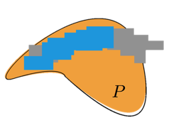
Hybrid Reachtubes
Track & propagate $may$and $must$fragments of reachtube
$$tagRegion\left(R,P\right)= \left\{\begin{matrix}must & R⊆P \\ may & R∩P≠∅ \\ not & R∩P=∅\end{matrix}\right.$$
$invariantPrefix(ψ,S)$ $=$
$〈R_{0}, tag_{0}, …, R_{m},tag_{m}〉$ , such that either
$tag_{i}=must$if all the $R_{j}^{′}s$before it are must
$tag_{i}=may$ if all the $R_{j}^{′}s$before it are at least may and at least one of them is not must

Slide 25
Guarantees for bounded invariance verification using discreapancy
Theorem. (Soundness). If Algorithm returns safe or unsafe, then $A$ is safe or unsafe.
Definition Given HA $A =〈V,Loc,A,D,T 〉$, an $ε$-perturbation of A is a new HA $A′$ that is identical except, $Θ^{′}=B_{ε}(Θ)$, $∀ ℓ∈Loc, Inv^{′}=B_{ε}(Inv)$ (b) a ∈ A, $Guard_{a}=B_{ε}(Guard_{a})$.
A is robustly safe iff $∃ε>0$, such that A’ is safe for $U_{ε}$ upto time bound T, and transition bound N. Robustly unsafe iff $∃ ε<0$ such that $A′$ is safe for $U_{ε}$.
Theorem. (Relative Completeness) Algorithm always terminates whenever the A is either robustly safe or robustly unsafe.
Notes:
14

Slide 26
static-dynamic analysis of nonlinear hybrid models
Compare execute check engine

Slide 27
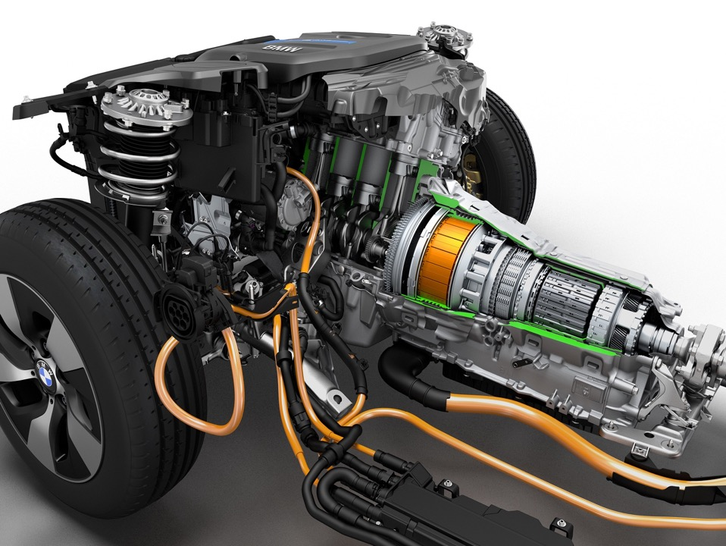
Powertrain control verification benchmark
Simulink model from [Jin et al. HSCC 2014]
Highly nonlinear polynomial differential equations; discrete mode switches
C2E2 first to verify properties, e.g., that the air-fuel ratio remains within a given range for a set of driver
[CAV 15] Duggirala, Fan, Mitra, Viswanathan: Meeting a Powertrain Verification Challenge.
Notes:
18

Slide 28
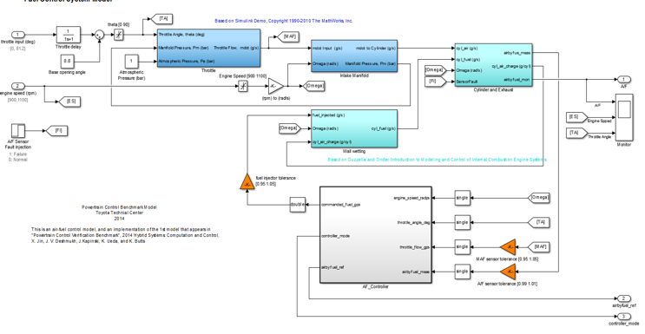
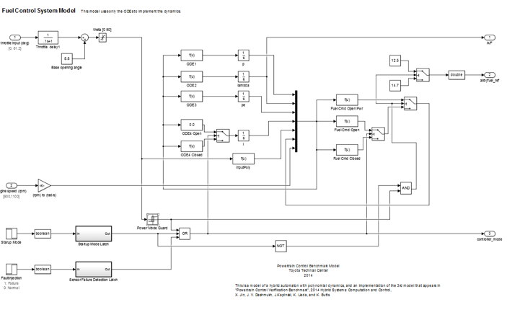
Benchmark Simulink models
Model 2
Continuous-Time Plant
+
Discrete-Time Controller
Transport delay
$→$first order filter
2nd order effects
$→$first order filter
Look up table
$→$polynomial fits
…
Make controller continuous-time
Polynomialize
Compose plant with controller

Slide 29
Polynomial hybrid automaton
startup
$$\dot{x}=f_{s}\left(x\right)$$
Variable | Description
$$θ_{in}$$ | Throttle angle
$$p$$ | Intake manifold pressure
$$λ$$ | Air/Fuel ratio
$$p_{e}$$ | Intake manifold pressure estimate
$$i$$ | Integrator state, control variable
$$timer=T_{s}$$
normal
$$\dot{x}=f_{n}\left(x\right)$$
$$sensorFail$$
$$θ_{in}≥{70}^{o}$$
$$θ_{in}≤{50}^{o}$$
sensor_fail
$$\dot{x}=f_{sf}\left(x\right)$$
power
$$\dot{x}=f_{p}\left(x\right)$$
$\dot{θ}=10(θ_{in}−θ)$
$\dot{p}=c_{1}(2θ\left(c_{20}p^{2}+c_{21}p+c_{22}\right)−c_{12}(c_{2}+c_{3}ωp+c_{4}ωp^{2}+c_{5}ωp^{2}))$
$\dot{λ}=c_{26}(c_{15}+c_{16}c_{25}F_{c}+c_{17}c_{25}^{2}F_{c}^{2}+c_{18}\dot{m_{c}}+c_{19}\dot{m_{c}}c_{25}F_{c}−λ)$
$\dot{p_{e}}=c_{1}\left(2c_{23}θ\left(c_{20}p^{2}+c_{21}p+c_{22}\right)−\left(c_{2}+c_{3}ωp+c_{4}ωp^{2}+c_{5}ωp^{2}\right)\right)$
$\dot{i}=c_{14}(c_{24}λ−c_{11})$
Notes:
19

Slide 30
Refinements in action: air-fuel ratio range
Requirement: Air-Fuel ratio $λ$contained in interval $\left[0.9λ_{ref},1.02λ_{ref}\right]$ for different initial conditions &throttle inputs
Notes:
19

Slide 31
An auto-pass controller
$$ω$$
$$s_{x}$$
$s_{x} v_{x} a_{x}$
Given a controller and a safe separation requirement, we would like to check that the system is safe with respect to
range of initial relative positions
range of possible speeds
range road friction conditions
possible behaviors of “other” car
range of design parameters
switch to left
overtake
gain threshold dist. d
switch to right
reach threshold dist. d
abort
Notes:
15

Slide 32
C2E2: Tool for nonlinear hybrid system verification
Notes:
Demo 16

Slide 33
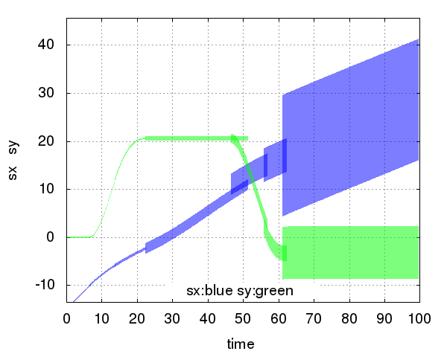
An auto-pass controller
Notes:
17

Slide 34
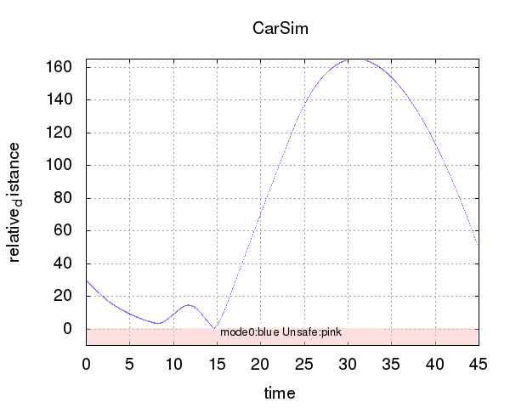
Debugging systems with high-fidelity models
Notes:
counter-example

Slide 35
Homework problem
Initial Set
Time Bound: 10s
Unsafe Set
Mode:Const_Const
Flow:
Inv: $t≤1$
Mode:Brake_Const
Flow:
Inv: $s_{1}−s_{2}≥10$
${\dot{s}}_{1}=v_{1}$
${\dot{v}}_{1}=0$
${\dot{s}}_{2}=v_{2}$
${\dot{v}}_{2}=0$
$\dot{t} =1$
${\dot{s}}_{1}=v_{1}$
${\dot{v}}_{1}=−2v_{1}$
${\dot{s}}_{2}=v_{2}$
${\dot{v}}_{2}=0$
$\dot{t} =1$
Guard: $t≥c_{1}$
Guard: $s_{1}−s_{2}≤c_{3}$
Reset: $t=0$
Mode:Brake_Brake
Flow:
Inv:$s_{1}−s_{2}≥0$
Mode:Brake_Const
Flow:
Inv:$t≤0.4$
Reaction time
${\dot{s}}_{1}=v_{1}$
${\dot{v}}_{1}=−2v_{1}$
${\dot{s}}_{2}=v_{2}$
${\dot{v}}_{2}=−3v_{2}$
$\dot{t} =1$
${\dot{s}}_{1}=v_{1}$
${\dot{v}}_{1}=−2v_{1}$
${\dot{s}}_{2}=v_{2}$
${\dot{v}}_{2}=0$
$\dot{t} =1$
Guard: $t≥c_{2}$

Slide 36
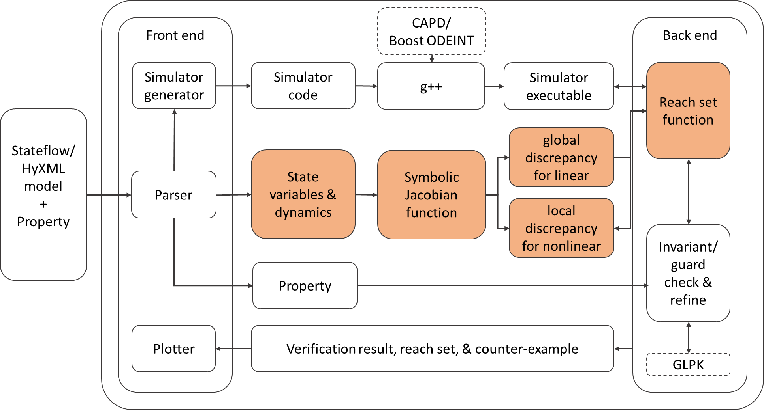
C2E2 Architecture

Slide 37
More features
Log file to debug
Plotted pictures are saved in the work-dir folder
Command line version

Slide 38
What we don’t know
Sample efficiency of the algorithms
Towards that [Girard Pappas 2006]
[Fan et al. EmSoft 2016] [Liberzon Mitra 2016]
Unbounded initial set and time horizon
How to verify open models?
$\dot{x}\left(t\right)=f\left(x\left(t\right), u\left(t\right)\right), x_{0}∈Θ u∈ 𝒰$
Ongoing work with $𝒰=\{u_{1},..,u_{k}\}$
More general models with uncertainty
Notes:
20

Slide 39
Hybrid models
$$f_{1}$$
$$f_{2}$$
$$f_{3}$$
$$f_{4}$$
$$f_{5}$$
$$f_{6}$$
$$f_{7}$$
$$f_{8}$$
$$f_{9}$$
Notes:
13
guard intersection
overapproximations = > spurious transitions
Tag sets ”overapproximations” may
More recent implementation -> sound over-approximations and separate simulations

Slide 40
Models closer to reality
$f_{1}$
$$f_{2}$$
?
?
?
?
$$f_{5}$$
$$?$$
?
$$?$$
$$?$$
$$?$$

Slide 41
“All models are wrong, some are useful”
https://github.com/qibolun/DryVR
Dry R
Gain serenity to accept models as they are

Slide 42
A new view of knowledge in hybrid models
Complete information of switching structure
Executable access to mode dynamics
DryVR’s Executable hybrid model
+
=
Transitions are time-triggered, possibly nondeterministic: one-clock timed automaton
Notes:
21: whitebox – timed automaton – graph
black box simulator

Slide 43
A new view of knowledge in hybrid models
Formal reasoning
simulation, composition
Statistical reasoning
sensitivity analysis
DryVR’s formal probabilistic guarantees
+
=
Notes:
22

Slide 44
DryVR model for Automatic Emergency Breaking
white brakes
blue brakes
red brakes
1
$$[t_{1},t_{2}]$$
2
$$[t_{1},t_{2}]$$
3

Slide 45
DryVR model for auto-pass
Accelerate
Accelerate
Decelerate
Accelerate
Turn_Right
Accelerate
2
3
4
1
7
5
6
Accelerate
cruise
Turn_Right
cruise

Slide 46
Learning discrepancy from black-box
Assume a form of the discrepancy
Global exponential discrepancy
$$β\left(x_{1},x_{2},t\right)=\left|x_{1}−x_{2}\right|Ke^{γt}$$
Others piece-wise exponential, polynomial
For any pair of trajectories $τ_{1}$ and $τ_{2}$ in mode ☐
$$∀t∈\left[0,T\right],\left|τ_{1}\left(t\right)−τ_{2}\left(t\right)\right|≤\left|τ_{1}\left(0\right)−τ_{2}\left(0\right)\right|Ke^{γt}$$
$$∀t,\ln{\frac{\left|τ_{1}\left(t\right)−τ_{2}(t)\right|}{\left|τ_{1}\left(0\right)−τ_{2}(0)\right|}≤γt+\ln{K}}$$
Familiar problem of learning linear separators
Notes:
where D(X) is the measure of set X under distribution D. Thus, the error is
the measure of points (w.r.t. D) that (a; b) is not a linear separator for.

Slide 47
Learning linear separators
For a subset $Γ⊆ℝ×ℝ$, a linear separator is a pair $\left(a,b\right)∈ℝ^{2}$ such that $∀\left(x,y\right)∈Γ, x≤ay+b$
Algorithm:
1. Draw $k$ pairs $\left(x_{1},y_{1}\right),…,(x_{k},y_{k})$ from $Γ$ according to $𝒟$.
2. Find $\left(a,b\right)∈ℝ^{2}$ s.t. $x_{i}≤ay_{i}+b$ for all $i∈\{1,…, k\}$.
Proposition [Valiant 84]: Let $ε,δ∈ℝ^{+}.$ If $k≥\frac{1}{ε}\ln{\frac{1}{δ}}$ then with probability $1−δ$, the above algorithm finds $(a,b)$ such that $err_{𝒟}\left(a,b\right)=$ $𝒟(\left\{\left(x,y\right)∈Γ \right| x>ay+b\})<ε.$
Experience: 96% accuracy for 10 trajectories, >99.9% for 20
Notes:
(4 mins)
where D(X) is the measure of set X under distribution D. Thus, the error is
the measure of points (w.r.t. D) that (a; b) is not a linear separator for.

Slide 48
DryVR
Complete information of switching structure
Executable access to mode dynamics
DryVR’s Executable hybrid model
+
=
Model file specifies vertices, edges, labels
Simulate function takes as input mode, initial state, and time horizon
Notes:
21: whitebox – timed automaton – graph
black box simulator

Slide 49
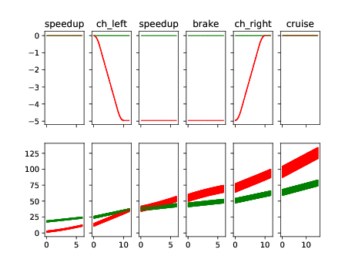
Reachability analysis
Accelerate
Accelerate
Decelerate
Accelerate
Turn_Right
Accelerate
2
3
4
1
7
Reach set of positions
5
6
time
Accelerate
cruise
Turn_Right
cruise

Slide 50
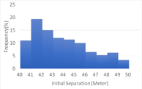
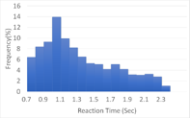
Automated Risk / ASIL Analysis
Risk = Probability x Severity
Notes:
25% of all accidents are rearend coll
85% on safe roads

Slide 51
Conclusions
Simulation data + sensitivity from models => algorithms => sound & complete invariance verification
Try C2E2 and DryVR give feedback, built on!
Examples available: Satellites to transistors
Several open questions about handling models with uncertainty and precise characterization of efficiency
This work is supported by grants form the United States National Science Foundation (NSF)
Notes:
24

